Slide 1
Consumer
Behavior

Slide 2
Course Objectives
Explain What is meant by Consumer Behavior
Describe the Types of Consumers
Explain Why do Consumers Buy
Explain the Importance of Consumer Behavior
Explain Role of Consumer Behavior in Loyalty
Explain the Model of Consumer Behavior
Explain Steps of Decision-Making Process
Explain How to Reduce Cognitive Dissonance
Explain Consumer Involvement in Buying Decisions
Explain the Types of Consumer Buying Decisions
Explain the Factors Influencing Consumer Behavior
Explain Role of Consumer Behavior & Satisfaction
Explain Role of Consumer Behavior for Relationship
Explain Role of CRM in Consumer Behavior
Explain Role of Consumer Behavior & Value Drivers

Slide 3
Introduction
Globus Inc. is a leading manufacturer of electronic goods and home appliances.
It now intends to venture into the mobile phones market.

Slide 4
Introduction
So, the management at Globus decided that Globus’ first product offering in the mobile market would be a ‘Sirius G1’.
‘Sirius G1’ would be their first latest Android-based smart phone.

Slide 5
Introduction
‘Sirius G1’ would come loaded with the latest features and completely new customized copyright software for download of updates, ringtones, wallpapers, application software etc.
So, do you think that Globus would be successful in its venture?

Slide 6
Introduction
‘Consumer Behavior’ also helps to improve their existing products to better suit the consumers’ needs, gain feedback about their products and services, develop ideas for future products based on consumer views etc.

Slide 7
Introduction
Hence, you can see that ‘consumer behavior’ is an important concept to be understood to understand the world of business.
Let us learn about ‘Consumer Behavior’ in detail.

Slide 8
What is meant by Consumer Behavior?
‘Consumer Behavior’ involves studying the processes a consumer uses to make purchase decisions, to dispose of purchased goods or services and study the factors that influence purchase decisions and the use of products.

Slide 9
Age
Age
Consumers can be various types and differentiated based on their ‘age’.
Consumers can be segregated into ‘sub-groups’ based on their age such as children, teenagers, young adults, mature adults, senior citizens and so on.
Each individual ‘sub-group’ has its own mind set, characteristics, preferred brands, preferred products etc.

Slide 10
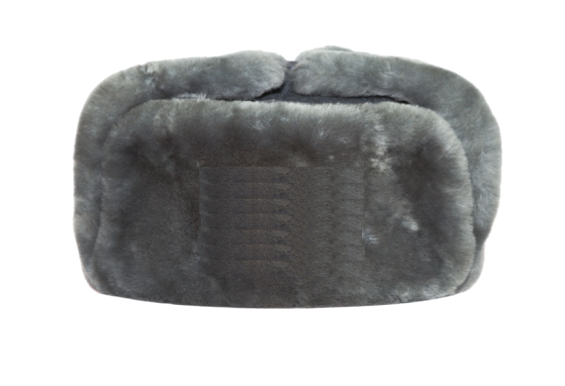
Real Life Example
Mikhail Lipinskii is the Vice President (Sales) at Globus Inc.
He is a very big fan of electronic gadgets.
He always buys different new electronic gadgets whenever they are introduced in the market.
Let us now understand the process that Mikhail uses to reach a purchase decision.

Slide 11
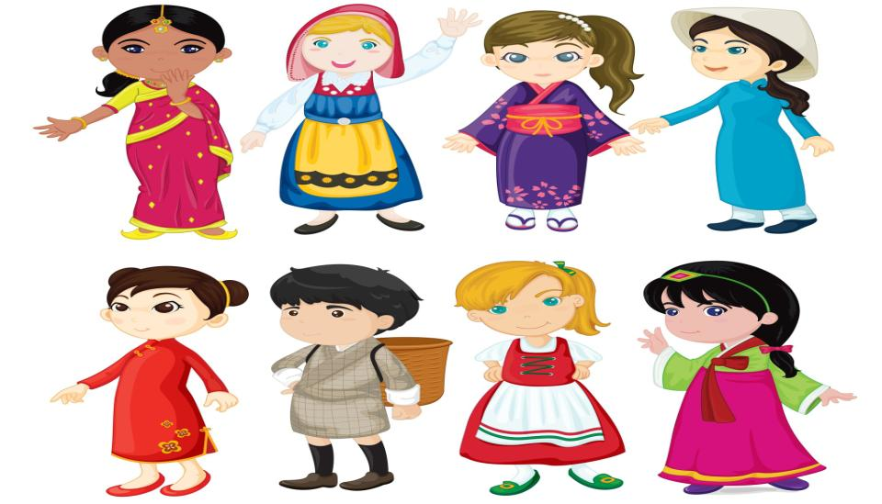
Cultural Factors
Cultural Factors
The word ‘Culture’ means a set of values, norms, attitudes, and other meaningful symbols that shape human behavior and the artefacts, or products, of that behavior as they are transmitted from one generation to the next.
It has been found ever since the prehistoric times that culture is: pervasive, functional, learned and dynamic.

Slide 12
Psychological Factors
Psychological Factors
There are various psychological factors that influence consumer behavior or consumer buying decisions such as follows:
Perception
Motivation
Learning
Beliefs and Attitudes
Let us look at each in detail.

Slide 13
ManagementStudyGuide.com
This is a DEMO Course On – Consumer Behaviour.
Become a Member and Get Access to Complete Powerpoint Presentations for more than 250+ Subjects.
What Do you Get:
View All Courses Online.
Download Powerpoint Presentation for Each Course.
Do the Knowledge Checks for Each Course.

