Slide 1
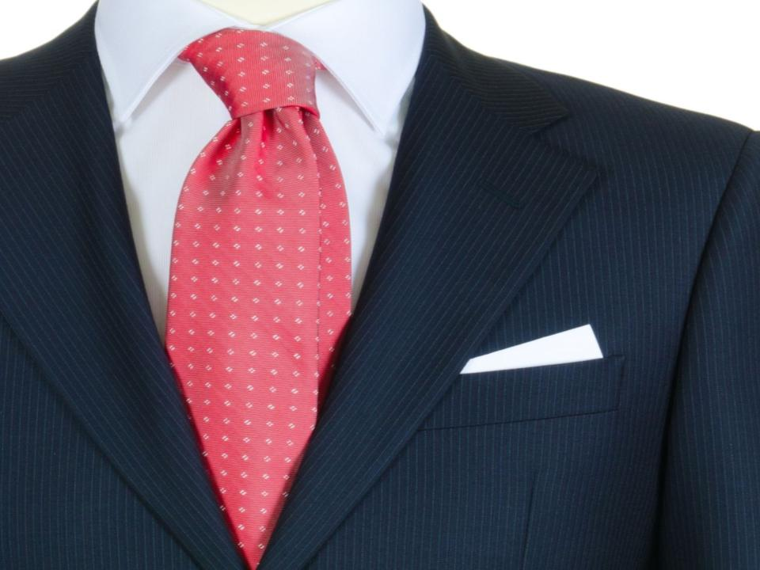
Corporate Etiquette

Slide 2
Course Objectives
Explain What is Corporate Etiquette
List the Benefits of Corporate Etiquette
Explain How to Show Etiquette in Communication
List the Common Courtesy Expressions
List the Phrases for Greeting
Explain the Steps to Make Introductions
Describe the Etiquette of Using Business Cards
Describe the Dining and Corporate Etiquette
Explain the Role of Body Language in Etiquette
Describe the Corporate Etiquette in Handshake
Describe the Norms of Dressing Etiquette
Explain the Hofstede Model to Analyze Cultures
List the Characteristics for Good Corporate Etiquette
Describe the Behaviors driving Corporate Etiquette
Describe the Behaviors to Avoid in Etiquette

Slide 3
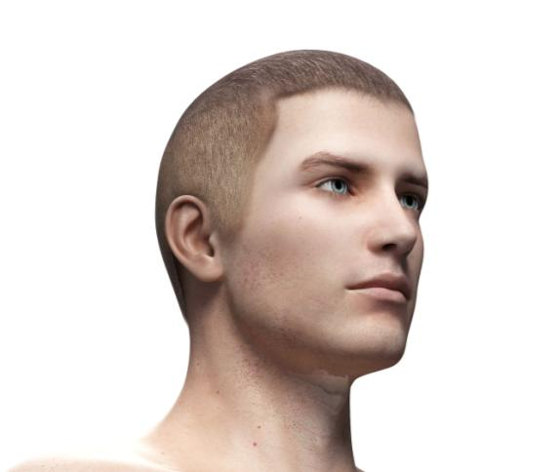
Introduction
Kevin Eastwood has been recently promoted as a Project Manager in Watson Inc. Watson Inc. is a leading provider of packaging material and logistics services to several clients across the globe.
Kevin is really excited by his promotion and hopes to handle his first project as a Project Manager.

Slide 4
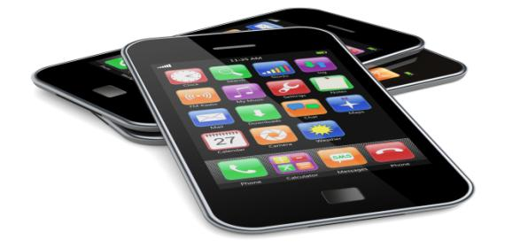
Introduction
Kevin’s first project is for Zeus Electronics, a leading electronics goods manufacturer.
Watson Inc. has to provide packaging material and logistics services for a new line of smart phones being launched by Zeus.

Slide 5
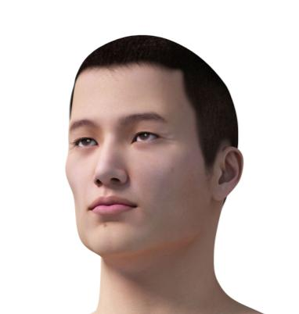
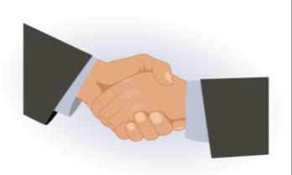
Introduction
Kevin arranges for a Project kick-off meeting with the client to understand their requirements.
Zheng Wu, the Product Head at Zeus will be attending the meeting as he is handling all the aspects related to the new line of smart phones being launched by Zeus.

Slide 6
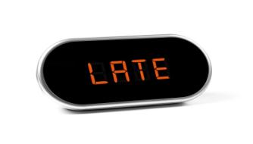
Introduction
Let us look at the conversation between Kevin and Zheng.
Good Morning! I am sorry I am late for the meeting. My name is Kevin Eastwood. I am the Project Manager and I will be handling this Project.
No problem. I am Zheng Wu, the Product Head at Zeus.

Slide 7
Introduction
Pleased to meet you, Mr. Wu. Shall we start the meeting?
Sure! As communicated to you through my Project Manager, Hansen, we would like the first consignment of the packaging material to be dispatched to us by end of next month. Then, the schedule of requirements would be different and we would inform the same to you at least six months in advance.

Slide 8
Introduction
Sure Sir! The first consignment will be delivered as per your requirement by the end of next month. However, we would like some clarification on the kind of box that you want the product to be packed in. We are not sure of the required thickness and material of the box.
Alright, I will send an email to you today itself after I reach office. Could you please send me a complete catalogue of the kind of material that you provide?

Slide 9
Introduction
Sure, I will do that. Would you like some tea or coffee?
Black Coffee is fine.

Slide 10
Introduction
Oh! I think you should not drink Black Coffee, I have heard it has many adverse effects on a person’s health. It has too much caffeine and also builds up a lot of heat in the body.
That’s fine! All the same, I would like to have a Black Coffee, please!

Slide 11
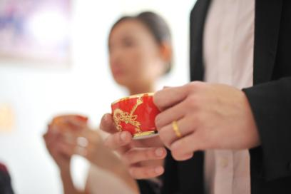
Introduction
Ok! I like tea a lot. I thought all Chinese people liked tea more than coffee. After all the Chinese discovered tea, right?
Yes, that’s right that the Chinese Emperor Shen Nong discovered tea but that definitely does not mean that all Chinese people may drink or like only tea!

Slide 12
Introduction
Yes, I suppose so. So, who else at your home prefers coffee to tea?
I am getting a bit late for another meeting. Maybe I’ll take a rain check on that coffee. I will ask Hansen, the Project Manager to email you the schedule and other details.

Slide 13
Introduction
Please do stay for a while. Your coffee won’t take long; I will just order it now.
No, thank you. Maybe some other time.

Slide 14
Introduction
Please email me your catalogue as well.
Sure, I will do that.
Ok, I will take your leave then.

Slide 15
Introduction
Sure, take care.
Goodbye!
Bye! Take Care!

Slide 16
Introduction
You have seen the conversation that took place between Kevin and Zheng at the Project kick-off meeting.
How do you think the conversation and meeting went?
Do you think Kevin proved to be good at his new role as a Project Manager in his first client meeting?
What do you think Kevin did wrong at the meeting?

Slide 17
Introduction
You have seen that Kevin made Zheng very uncomfortable at the meeting. Hence, you can understand that ‘Corporate Etiquette’ is crucial for conducting oneself in the right and professional manner in a business environment. The right ‘Corporate Etiquette’ adopted by an individual can make him more professional, likable, polite, courteous and approachable.
Let us learn about ‘Corporate Etiquette’ in detail.

Slide 18
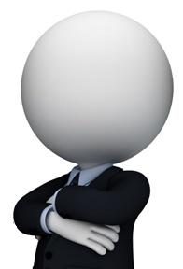
What is Corporate Etiquette?
‘Corporate Etiquette’ is defined as the code of ethical and honourable behavior with respect to a professional practice or behavior among the members of a profession in their dealings with each other.

Slide 19
Employee Engagement
Branding
Customer Care
Employee Engagement:
‘Employee Engagement’ is crucial to the smooth and successful working of a company.
Corporate Etiquette helps to use your good workplace behaviour and manners to help improve your confidence.
Employee Engagement
Employee Engagement
Team Synergy

Slide 20
Corporate Etiquette and Communication
The following are a few methods through which you can adhere to the norms of corporate etiquette while communicating with others. They are:
1
2
Show that you
are listening
Show that you are listening:
Show the speaker that you are listening by using your own body language and gestures.
Nod occasionally.
Smile and use other facial expressions.
Keep your posture open and inviting.
Use small verbal comments like “yes”, and “uh huh” to encourage the speaker to continue.
3
4
5
Let us look at each in detail.

Slide 21
Using EOM Headlines
The following are a few points to be considered to write effective emails in keeping with the norms of email etiquette:
1
Using EOM Headlines -
In order to convey a very short message to convey, you can use the EOM, or End Of Message, technique. You can put all the relevant information in the subject line, followed by the letters "EOM". This lets the recipient know that he or she doesn't even have to open the email; all the information is right there. The subject line is the message.
2
3
4
Using EOM Headlines
5
Let us look at each in detail.

Slide 22
Don'ts of Meeting Etiquette
Avoid being late to the meeting.
Do not talk to your friend across the table in sign language while the meeting is on.
Do not rush out of the room when the meeting is done. Thank the person who conducted the meeting and then leave.
Respond to the meeting request even if you are unable to go to the meeting and inform the person conducting the meeting of the same.

Slide 23
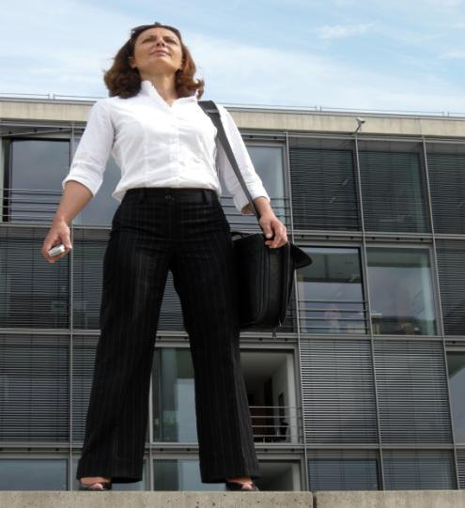
Cast Warmth and Confidence
Cast Warmth and Confidence
The first and most important step of making introductions as well as while introducing oneself is to project great warmth towards the other person and to project great confidence.
It is also crucial that while introducing yourself you pay great attention to your body language.
This is because people may deduce many things about you from your body language.

Slide 24
Dining and Corporate Etiquette
The following are a few guidelines to keep in mind while dining in a business or formal environment:
The beginning of the meal is signalled when the host unfolds his or her napkin.
You should work your way inwards by starting with the knife, fork, or spoon that is farthest from your plate. You should always use only one utensil for each course.
Put your napkin on your lap when drinks are served, in situations where there is no host during a business meal.
Always keep in mind that the salad (smaller) fork is on your outermost left, then followed by your dinner fork. Your soup spoon is on your outermost right, followed by your beverage spoon, salad knife, and dinner knife. Your dessert spoon and fork are above your plate or brought out with dessert.

Slide 25
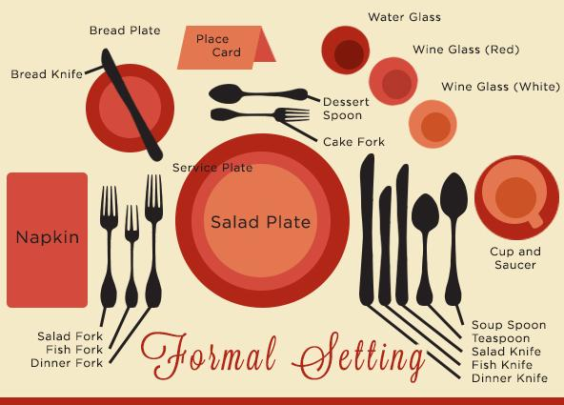
Formal Table Setting
Various utensils laid out on the dining table are:
Salad Plate
Service Plate
Bread Plate
Bread Knife
Salad Fork
Dinner Fork
Dinner Knife
Teaspoon
Soup Spoon
Dessert Spoon
Cake Fork
Napkin
Place Card
Water Glass
Red Wine Glass
White Wine Glass
Cup and Saucer

Slide 26
Speech
Some of the common signs of body language that display etiquette and are of a confident person are:
1
Posture
2
2
Speech
Speech
3
Speech:
Person should speak in a slow and clear manner to show politeness and manners.
Eye contact
4
Tone of voice
Gestures with hands and arms
5
Let us look at each in detail.

Slide 27
Corporate Etiquette and Handshake
A handshake is an important part of everyday professional life and corporate etiquette. You meet many people in your professional environment and a ‘handshake’ can help form the crucial ‘first impression’ on each new person that you meet and show your manners and courtesy. There are various types of handshakes and each may indicate a different impression of the person making the handshake.

Slide 28
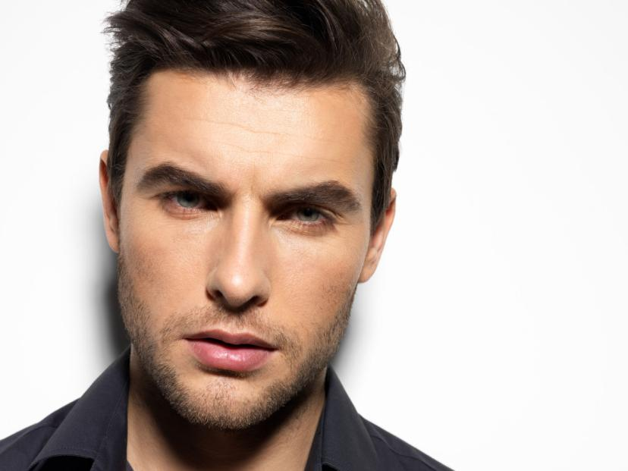
Real Life Example
Nick is not sure what he should wear to work on a Tuesday.
Yale Software Inc. follows a formal dress code from Mondays to Thursdays and a casual dress code on Fridays.

Slide 29
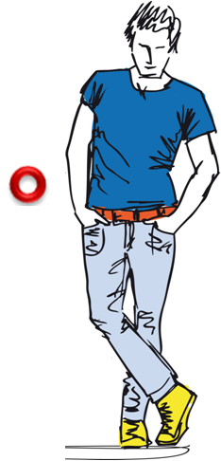
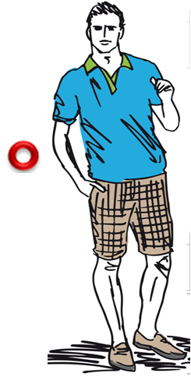
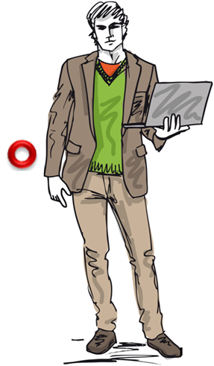
Real Life Example
Can you help Nick choose the best suited clothes to wear keeping in norms of ‘Corporate Etiquette’?
Click on a radio button to choose the right option.

Slide 30
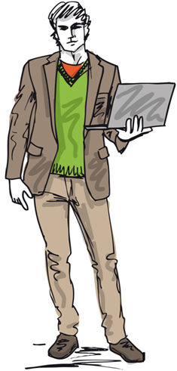
Real Life Example
Good! That’s Right!
Click on the ‘Next’ button to continue
NEXT

Slide 31
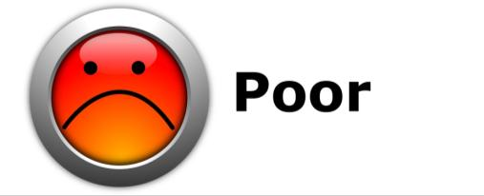
Real Life Example
That’s not quite right!
Click on the ‘Next’ button to continue
NEXT

Slide 32
ManagementStudyGuide.com
This is a DEMO Course On – Corporate Etiquette.
Register Today and Get Access to many FREE Courses.
What Do you Get:
View All Courses Online.
Download Powerpoint Presentation for Each Course.
Do the Knowledge Checks for Each Course.

