Slide 1
Train the Trainer

Slide 2
Introduction
Globus is a telecom giant which provides various mobile and broadband related services.
Hazel Smith joined Globus Inc. as a process trainer.
Hazel will be responsible for training the technical support executives who cater to various queries for solving technical issues.

Slide 3
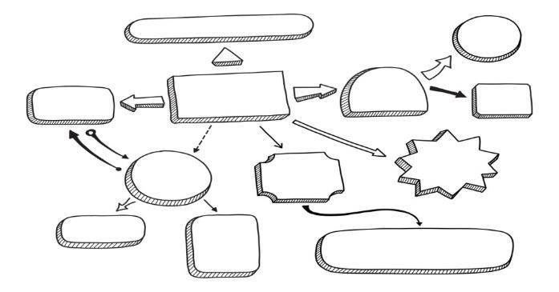
Introduction
As Hazel is new to Globus Inc., she is not aware of the technical support process followed by Globus, the customer profiles, geographical areas being served by Globus etc.

Slide 4
Introduction
The answer to that lies in the ‘Train the Trainer’ program. Globus has a proper defined ‘Train the Trainer’ program in place. So, any new trainer who joins Globus goes through the ‘Train the Trainer’ program where he/she first learns the process from a senior experienced trainer. Then, after the ‘new trainer’ has been trained, he/she is now ready to train the technical support executives.

Slide 5
Introduction
Let us learn about ‘Train the Trainer’ program in detail.
Thus, you can see that the ‘Train the Trainer’ program is crucial for a completely inexperienced trainer or a trainer who has joined a new organization. The ‘Train the Trainer’ program helps the trainer to be familiar with the processes and the training program followed by the organization. It helps the trainer to be confident of being capable of training others.

Slide 6
Objective
Explain the Need for Training and Development
Explain the Various Roles of a Trainer
Describe the Various Learning Styles and their Importance
Explain the Phases of a Training & Development Program
List the Criteria for Evaluation of Training
Describe How to Plan and Organize Training Content
Explain How to Prepare Presentations for Training
Explain the Role of Training Room Configuration in Effective Training
Explain the Role of Games and Activities in Training
Explain the Ground Rules for Communication in a Training
Explain How to Handle Different Learners
Explain the Role of Body Language in Training
Explain the Expectations of Learners from Trainers
Explain the Challenges of Training
List the Characteristics of a Good Trainer

Slide 7
Roles of a Trainer
The trainer plays several different roles while conducting training and passing on the learning to the learner:
Planner
Expert
Instructor
Facilitator
Resource Person
Role Model
Co-Learner
Let’s look at each in detail.

Slide 8
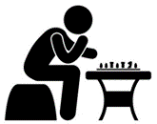
Learning Styles and their Importance
There are Seven Learning Styles as follows:
•
•
•
•
•
•
•
Visual
Aural
Verbal
Physical
Logical
Social
Solitary
Let’s look at each in detail.

Slide 9
Phases of a Training & Development Program
Phase I – Needs Assessment/Needs Analysis
The first phase of the training and development program involves a detailed needs assessment or needs analysis of the prospective participants of a training program.
This phase involves carrying out a detailed analysis to determine the organization’s true actual needs and the training programs that will be required to meet those needs.

Slide 10
Planning and Organizing Training Content
Once you have decided on the need for a training to be conducted, the next step is to plan and organize the content to be presented in your training. Useful initial techniques for planning and organizing training content are:
Brainstorming
Mind mapping
Developing List of Topics and Sub-topics to be Covered
Let’s look at each in detail.

Slide 11
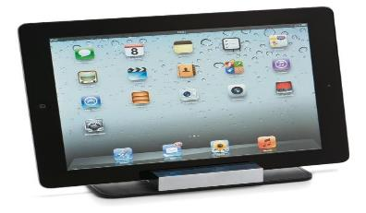
Training Room Configuration
Size of the room:
How many people will attend the training session? Too big a room gives an isolated feeling, and too small a room makes people feel cramped and uncomfortable.
Size of the room: How many people will attend the training session? Too big a room gives an isolated feeling, and too small a room makes people feel cramped and uncomfortable.

Slide 12
Games and Activities in a Training
Activities and games help to make the communication effective between co-participants in a training. Every individual is very clear about his goals and objectives and what exactly is expected from him.
Such games must be flexible enough and take into consideration the fact that learners come from different backgrounds, have different mental levels, different potential, different patience rate and an amalgamation of other differences. Such games assist in learner motivation also.

Slide 13
ManagementStudyGuide.com
This is a DEMO Course On – Train the Trainer
Subscribe Today and Get Access to 250+ Course Presentations.
What You Get:
Access the Courses Online.
Download Powerpoint Presentation for Each Course.
Get Certificates.

