Slide 1
Memory Skills

Slide 2
Introduction
Jonathan Scheich is a manager at Globus Inc.
Jonathan is an efficient and greatly talented employee.
His bosses and subordinates greatly appreciate his work and capabilities.
However, one major complaint that his subordinates have is that he always tends to forget things.
He constantly needs to be reminded of important meetings, schedules, deadlines and even people’s names.

Slide 3
Introduction
Jonathan maintains an online diary and calendar to remind him of his deadlines and schedules.
However, in his busy routine he tends to overlook and forgets even the reminders given by his online calendar.
His subordinates are not very happy with him as a manager and a leader because he always forgets their important days and misses out on wishing them on their birthdays and anniversaries.
Many times, he even forgets the new employee’s names and has to be constantly reminded of their names.

Slide 4
Introduction
Jonathan is a good manager but is not considered so by his subordinates due to his simple habit of forgetting.
Jonathan does not consider his poor memory skills as something that he needs to work on.
However, Jonathan is completely wrong to think that way.

Slide 5
Course Objectives
Explain What is Memory
Explain the Importance of Memory
Explain Atkinson-Schiffrin Three-stage Model of Memory
Describe the Three Phases of Memory Activity
Describe the Retrieval Memory Effects
Explain the Analogy between Computer System and Memory System
Explain What is Retrieval Failure
Explain the Types of Interference
Describe the Techniques to Improve Memory
Explain What are Mnemonics
Explain What is the ‘Link’ Method
Explain the Strategies for Remembering Names
Explain the Strategies for Remembering Faces
Explain the Strategies for Remembering Important Numbers
List the Tips for Improving Memory

Slide 6
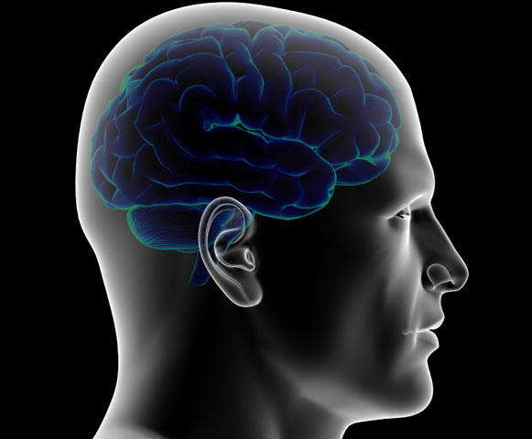
What is Memory?
Memory is a boon to the human kind.
Memory forms the basis due to which you identify, recognize and know your loved ones, friends, neighbors, enemies, language, skills, national anthem and everything that you know about yourself and your environment.

Slide 7
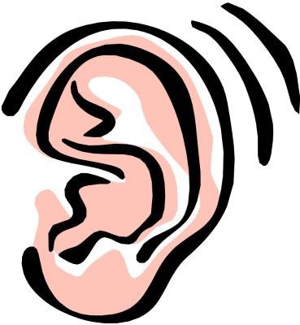
Sensory Memory
The duration of the memories varies for the different senses as shown in the image given below:
Iconic – 0.5 sec long
Echoic – 3 – 4 sec long
Hepatic – <1 sec long

Slide 8
Why do we Forget?
‘Forgetting’ is an inability to retrieve information due to poor encoding, storage, or retrieval.
It has been found that we filter, alter, or lose much information during the various stages of information processing.
Therefore, forgetting can occur at any memory stage.

Slide 9
Memory Construction
It has been found that when an individual tries to tap into his memories, he tends to filter or fill in missing pieces of information to make his recall more coherent. There are various factors which influence the memory construction of a person such as follows:
Misinformation Effect
Source Amnesia
Imagination Effect

Slide 10
Real Life Example
In an earlier scenario, you had seen how Jonathan is not appreciated as a manager by his subordinates due to his poor memory skills.
Now, you have learned about the various techniques and ways by which you can observe better, remember facts, faces, dates and figures and improve your memory skills.
Use the techniques that you have learned and help Jonathan in remembering the details about his subordinates.

Slide 11
Numbers to Sentences
In this method, you have to convert each digit into a word with as many letters as the number. So, the number 3 can be converted into a word such as ‘FOR’ or ‘HIS’ or HER’.
1
Numbers to Sentences
2
Example: A person’s Debit Card PIN is 2425. Now, in order to remember this PIN, he should convert the each digit in the PIN ‘2425’ to a word such as follows:
2 4 2 5
MY NAME IS DAISY
Now, if the person wants to remember his Debit Card PIN, he has to simply remember the simple sentence ‘MY NAME IS DAISY’ which is easier to remember than the number.
3
4

Slide 12
ManagementStudyGuide.com
This is a DEMO Course On:
Memory Skills
Subscribe Today and Get Access to Unlimited Courses.
What You Get:
Access the Courses Online.
Download Powerpoint Presentation for Each Course.
Get Course Completion Certificates.

