Slide 1
Anger Management

Slide 2
Course Objectives
Explain What is Anger
Explain What is Anger Management
List the Advantages and Disadvantages of Anger
Explain the Triggers of Anger
Describe the Internal Cues to Anger
Describe the Types of Anger
Explain the Steps for Anger Management
Explain What is CUDSAIR
Explain the Use of Relaxation for Anger Management
Describe the Strategies to Control Anger
Explain the Use of Effective Communication
List the Tips to Keep Cool

Slide 3
Introduction
Henry Gordon works as a Project Manager in a reputed MNC. He has been facing a lot of problems because of his inability to control his temper.
His wife is unhappy with Henry’s frequent angry outbursts and has finally stopped trying to reason with him.
Henry’s sub-ordinates are scared of him and do not voice their views and opinions in front of him.

Slide 4
What is Anger?
Anger is ‘an emotional state that varies in intensity from mild irritation to intense fury and rage.’
Anger is a secondary emotion.
Another emotion, such as fear, frustration, anxiety, sorrow, or feeling diminished, inevitably precedes the experience of anger.
Generally, anger replaces these primary emotions so quickly that we never notice them. Beneath the primary emotions lie unmet needs.

Slide 5
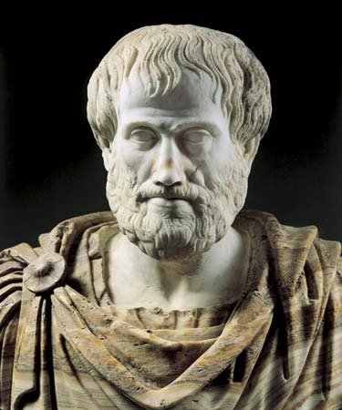
What is Anger Management?
To understand what anger management is, look at a famous phrase said by the well-known Greek philosopher, Aristotle.
So, anger management is all about learning to be angry with the right person, to the right degree, at the right time, for the right purpose, and in the right way.
“Anybody can be angry. That is easy. But to be angry with right person, to the right degree, at the right time, for the right purpose, and in the right way, that is not easy.”
-Aristotle

Slide 6
Factors that Affect Anger in a Person
The following are some factors that can impact how we respond to conflict and cause us to get angry:
Determining the best mode:
We develop an understanding of resolving conflict with people through practice. We use these to determine when to use anger with the particular person with whom we are in conflict.

Slide 7
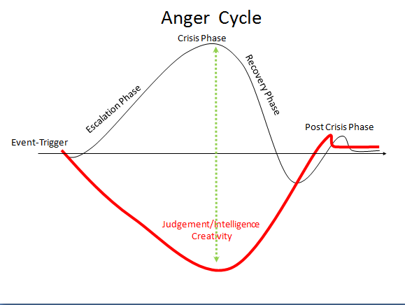
Anger Cycle

Slide 8
Types of Anger
Self-inflicted Anger
Self-inflicted Anger:
Self-inflicted Anger is the one that is directed toward a person’s own body.
Sometimes, people showing this type of anger tend to starve themselves or eat too much.
These are the people who believe in the idea of punishing their own self for something wrong they have or others have done.

Slide 9
Hostility Log Sheet
 | What Made You Angry? | How Did You Respond? | Was this Justified?
Monday
Tuesday
Wednesday
Thursday
Friday
Saturday
Sunday

Slide 10
CUDSAIR
Professor Richard Nelson-Jones of the UK has developed a good structure to use for anger management called CUDSAIR. The acronym ‘CUDSAIR’ stands for:
C – Confront
U – Understand
D – Define
S – Search
A – Agree
I – Implement
R – Review

Slide 11
Strategies to Control Anger
Following are some of the strategies to control anger:
1
Keep your voice low
2
Breath slowly and deliberately
3
Count to ten

Slide 12
ManagementStudyGuide.com
This is a DEMO Course On – Anger Management.
The Complete Course Presentation consists of 156 Slides.
Become a Member and Get Access to Complete Powerpoint Presentations for more than 250+ Subjects.
What You Get:
View All Courses Online.
Download Powerpoint Presentation for Each Course.
Do the Knowledge Checks for Each Course.

