Slide 1

Basics of English Speaking for Workplace

Slide 2


Course Objectives
Explain the Various Parts of Speech
Explain the Rules of Grammar
Describe the Role of Vocabulary in Speaking
Describe the Role of Body Language in Speaking
Explain How to Use Your Voice Professionally
Describe the Role of Questioning in Speaking
Describe the Role of Listening in Speaking
Describe the Role of Introductory Phrases
Describe the Role of Interrupting Phrases
Describe the Role of Fillers in Speaking
List the Common Courtesy Expressions
List the Phrases for Greeting
List the Phrases Used in Telephonic Conversations
Explain How to Speak in Discussions/Meetings
Explain How to Speak to an Audience

Slide 3


Introduction
Enrique Dominic is a Key Accounts Manager in Globus Inc., a leading advertising firm. Enrique is often required to give presentations in front of clients.
Although, Enrique is a highly creative and talented individual, he lacks the skills of speaking fluently in English. He is also not very confident about speaking in front of a group of people.

Slide 4


Introduction
Enrique often avoids giving such presentations and delegates the task to one of his subordinates. However, Enrique’s boss insists that Enrique should give the presentation in front of the clients of his major accounts.
Enrique is not a native language speaker and hence is not able to structure his sentences well. He tends to translate sentences from his native language into English and speak them. This leads to several grammatical errors in his English.

Slide 5

Introduction
Enrique’s boss feels that Enrique is not able to advance in his career because of the major disadvantage that he faces while speaking in English.
Globus has a large majority of international clients. Hence, speaking in fluent and correct English is a core requirement of any employee of Globus.

Slide 6
Introduction
Enrique’s boss was thinking of sending him to England on a project for a reputed client.
However, seeing Enrique’s discomfort in speaking in English, his boss decides to send Enrique’s sub-ordinate for this project.

Slide 7
Introduction
Enrique gets very frustrated by this major set-back in his career and decides that this is high time he learns to speak English fluently.
Thus, you can see that speaking in English is a major requirement in today’s professional life. Let us learn about basics of speaking in English at workplace.

Slide 8


Parts of Speech
Words in English Grammar are classified based on eight ‘Parts of Speech’.
A part of speech does not explain the meaning of the word. However, it does explain how the word has been used in a particular sentence.
Hence, a word may be used as a ‘noun’ in one sentence and may be used as an ‘adjective’ or a ‘verb’ in another sentence.

Slide 9

Types of Nouns
There are many different types of nouns. Also, you should keep in mind that a noun will belong to more than one type.
The types of nouns are:
Collective Nouns
Concrete Nouns
Abstract Nouns
Common Nouns
Countable Nouns
Non-Countable Nouns
Proper Nouns
Let’s look at each in detail.

Slide 10

Parts of Speech
Preposition
A word that is used to link nouns, pronouns and phrases to other words in a sentence is known as a ‘Preposition’. The word or phrase that the preposition introduces is called the object of the preposition.
For example, the highlighted words in the speech bubble are all prepositions:
The mobile is on the table.

Slide 11
Rules of Grammar
Rule I: The table given below shows how to use a ‘pronoun’ as a subject with the ‘verb to be’.
Subject (Pronoun) | VERB TO BE
He | Is (was)
She | Is (was)
It | Is (was)
I | Am (Was)
You | Are (Were)
We | Are (Were)
They | Are (Were)

Slide 12
Rules of Grammar
Rule VII: The table given below shows the use of main verb and auxiliary verbs.
NEGATION
MAIN VERB
AUXILIARY VERB
A1. Harry met Sally.
A. She is a teacher.
A2. Harry did not meet Sally.
a. She is not a teacher.
B1. I go to gym every day.
B. She has eaten.
B2. I do not go to gym every day.
b. She has not eaten.
C1. He adores his mother.
C. They will fly.
C2. He does not adore his mother.
c. They will not fly.

Slide 13


1
Using Your Voice Professionally
Your primary tool for instruction while speaking is your voice. When speaking to anyone, think about projection, pace and modulation.
Projection: The volume of your voice should be loud enough that the other person can hear you. At the beginning of the discussion, ask if your audience can hear you and adjust your volume accordingly.
Pace: Make sure you are not going so fast that people cannot keep up, or so slow that people get bored and stop paying attention. You can also use strategic pauses, such as pausing just before an important point in order to emphasize it.
Modulation: Varying your inflection and volume will keep your audience's attention, whether your natural speaking voice is high or low, loud or soft.
Voice

Slide 14
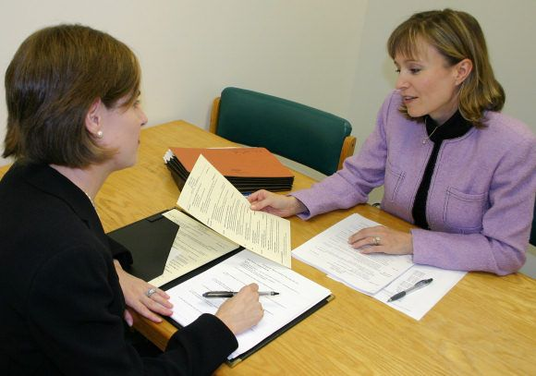
Questioning and Speaking
Open Questions
Open Question:
Open questions evoke longer answers.
Open questions usually begin with what, why, how.
Such a question asks the respondent for his or her knowledge, opinion or feelings.
Example:
  Why do you feel our service is not good?

Slide 15
Key Elements of Active Listening
Provide feedback:
Paraphrase what is being said to reflect your understanding of what is being spoken.
Ask questions to clarify certain points.
Summarize the speaker's comments periodically.
Pay attention
Respond Appropriately
Show that you are listening
Defer judgment
Provide feedback

Slide 16


Interrupting Phrases
Interruptions should be used to flow naturally in a speaking style. Interruptions help to add a pause to catch the listener’s interest before adding some valuable information to the conversation.
Example:
I really wish to help in solving this; nevertheless, I can help only if I get all the correct information.

Slide 17
Fillers
Fillers are apparently meaningless words, phrases, or sound that mark a pause or hesitation in speech.
The best way to use a filler is to omit a pause and then use a filler word.
However, one should not use too many filler words as it gives the impression of being nervous, being unprepared, unconfident, vague and not very clear on what one wants to speak.

Slide 18

Real Life Example
Read the dialog given below. This exercise will help you to practice speaking dialogs. Each dialog includes a number of questions which you need to answer. Once, you have replied to a dialog or question, click on the ‘You’ icon to view a sample answer. Each dialog is in a number of tenses, so read carefully to understand the tense and answer using an appropriate sentence. Note: Please keep in mind that your answers may differ from the sample answers given below.

Slide 19

Telephone Handling
The following considerations should be kept in mind while handling telephone calls:
Answer call within two rings
Speak softly, slowly and clearly
Avoid speaker phone
Note down the message if you are answering for someone else
Be courteous and pleasant
Check if receiver is free to talk if you are going to make a call

Slide 20


Speaking to an Audience
Sometimes in our workplace or in personal situations, we may be required to speak to and address an audience.
The norms of speaking to an audience are slightly different from when one is speaking to an individual.
Effectively engaging an audience is dependent on the speaker's ability to sound interesting and convey a positive attitude.
Developing good speaking skills involves an increased awareness of your voice, language, body language and tone while teaching.

Slide 21


ManagementStudyGuide.com
This is a DEMO Course On – Basics of English Speaking at Workplace.
Join MSG Today and Get Access to Unlimited Courses.
What You Get:
View All Courses Online.
Download Powerpoint Presentation for Each Course.
Do the Knowledge Checks for Each Course.

