Slide 1
Source
Message
S
M
C
R
Channel
Receiver
Berlo’s Model of Communication

Slide 2
Course Objectives
Explain the Communication Process
Describe the Components of Communication
List the Various Communication Models
Explain What makes Communication Ineffective
Explain the Importance of Berlo Model of Communication
List the Key Characteristics of Berlo Model
Explain Berlo’s Model of Communication
Explain Ways of Treatment of Messages
Describe the Criticism of Berlo’s Model of Communication
List the Tips to Apply Berlo’s Model of Communication

Slide 3
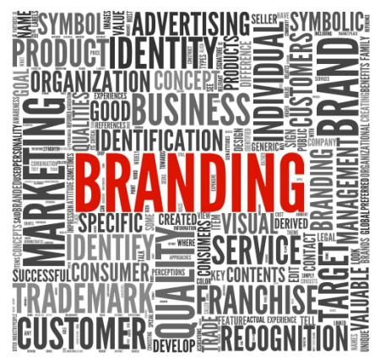
Introduction
Perseus Branding Services Inc. is a leading provider of branding solutions to companies such as creating websites, brochures, visiting cards, letter heads, logos etc.

Slide 4
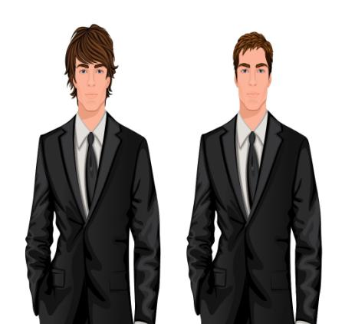
Introduction
Keith Dawson has approached Perseus to get a brochure created for showcasing the services offered by his company to his clients.
Look at the conversation between Keith and Liam Parker, a Manager at Perseus to understand the relevance of the right message for effective communication in a business transaction.

Slide 5
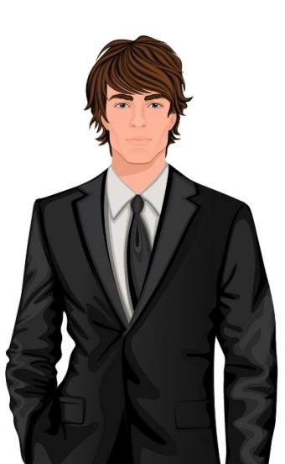
Introduction
Hello, My name is Keith Dawson. I would like to get a brochure printed for showcasing the services offered by my company.
Thank you, Mr. Dawson for considering our organization for your requirement. My name is Liam Parker. I am the manager. Do you have any idea about the design of the brochure in your mind?
Keith
Liam

Slide 6
Introduction
Logo
Company Name
Keith
Yes. I would like that a two-fold brochure should be created. It should have my company logo in the right hand corner. The upper part of the brochure should have a red band across it. The font type should be stylish.

Slide 7
Introduction
Company Name
Logo
Liam
Sure, Sir. We will surely design a brochure the way you want it. I will get my designer to get a sample proof ready for you. It will be ready in a week’s time. You can have a look at it and then we can go ahead with the printing. Please give me the details of the services that would go as content on the brochure. We would enhance the content and get the copywriting done as well.

Slide 8
Introduction
Great! Here are the details of the services offered by my company. Please feel free to call me in case you need any other information. This is my business card.
Thank you, Sir!
Keith
Liam

Slide 9
Introduction
Liam then speaks to his designer.
Matt, we have a requirement of a business brochure to be printed for a customer. He wants the brochure to be two-fold and have stylish font. The company logo should appear in the corner. The brochure should have a red band running across the upper half of the brochure.
Sure, Liam. I will get the sample ready at the earliest.
Liam
Matt

Slide 10
Introduction
Now, look at the brochure design given below.
This is the kind of design that Keith, the customer had wanted.
Logo
Company Name
Keith

Slide 11
Introduction
However, when he conveyed his message and described the brochure, look at how Liam understood it.
Company Name
Liam
Logo

Slide 12
Introduction
Likewise, when Liam described it to Matt, he understood it totally differently.
Logo
Matt
Company Name

Slide 13
Introduction
Look at the three brochures. They are all different from what Keith had originally wanted.

Slide 14
Introduction
This happened due to improper communication between the three people involved and the message not being properly understood when it was conveyed by Keith.
Keith
Liam
Matt

Slide 15
Introduction
You can understand that Keith may not place the order after looking at the sample brochure, or if decides to try again, he would still have to wait for another week to get another sample ready.
Such lack of proper communication in any walk of life including a business scenario can lead to great confusion and even losses in a business. In both cases, it is a loss to the business and a hassle to the customer.

Slide 16
Introduction
Hence, you can understand that communication is very important in all walks of life – at a personal level as well as at a professional level. Also, conveying the message is as important as understanding the message correctly.
‘Berlo’s Model of Communication’ is one of the simplest and most influential message-centered models. It believes that effective communication can be achieved by stressing on the content of the message.
Let us learn about ‘Berlo’s Model of Communication’ in detail.

Slide 17
Components of Communication Process
Message
Sender
Encoding
Decoding
Receiver
Media
Feedback
Response
The main components of communication process are as follows:
Context
Sender / Encoder
Message
Medium
Recipient / Decoder
Feedback
Let us look at each component in detail.

Slide 18
David Berlo
David Berlo was a scholar and professor at the University of Illinois and the Michigan State University.
He was also the President of Illinois State University.
In 1960, David Berlo wrote a book titled 'The Process of Communication: An Introduction to Theory and Practice'.

Slide 19
Did You Know?
Studies have found that people only remember between 25% and 50% of what they hear. So, it is important to become an “active listener”. "Active listening" involves making a conscious effort to hear not only the words of the speaker but also to try to understand the complete message being sent.

Slide 20
Importance of Berlo Model of Communication
Berlo’s Model of Communication became very prominent as one of the simplest and most influential message-centered model. It became very significant after the World War II as:
The notion of a ‘source’ included various options such oral, written, electronic, or any other kind of ‘symbolic’ generator-of-messages.
The transmission of the ideas was stressed upon by making the ‘Message’ the central element.
The model also gained popularity as it laid stress upon and identified the receivers as the targets and being an important part of communication.
The model explained the concept of encoding and decoding and how these affected and caused problems in translating one’s thoughts into words or other symbols and in decoding the words or symbols of others into terms we ourselves can understand.

Slide 21
Berlo’s Model of Communication
S
C
In the ‘SMCR’ Model, the acronym ‘SMCR’ stands for:
M
R
Source
Channel
Message
Receiver
Let us look at each in detail.

Slide 22
S
S - Source
Source
The source in other words also called the sender is the one from whom the thought originates. He is the one who transfers the information to the receiver after carefully putting his thoughts into words.
How does the source or the sender transfer his information to the recipient?

Slide 23
Element
Any message further comprises of the following elements:
1
2
Element
Element:
It has been observed that speech alone cannot bring a difference in the communication.
Keep on constantly speaking and the listeners will definitely lose interest after some time.
3
4
5
Let us look at each in detail.

Slide 24
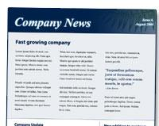
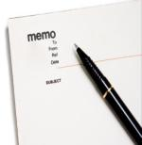
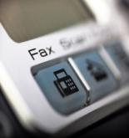
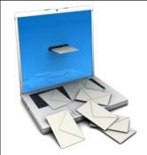
Types of Formal Channels
Company newsletters
Employee handbooks
Company magazines
Formal meetings
Letters
Flyers & bulletins
Memos
Faxes
All-employees mailings

Slide 25
Berlo’s Model of Communication

Slide 26
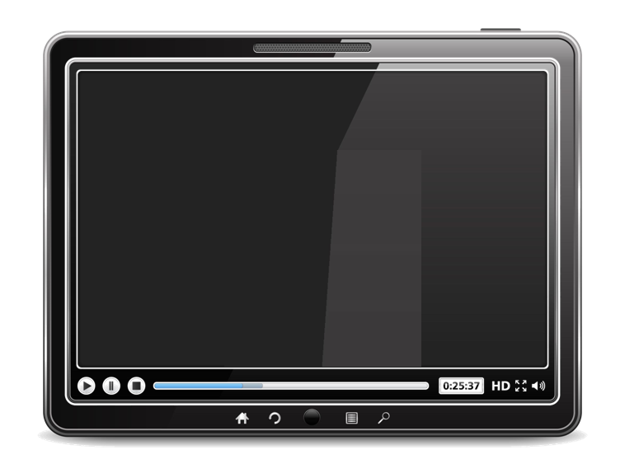
Criticism of Berlo’s Model of Communication
The following are a few criticisms or pitfalls of Berlo’s Model of Communication:
The model excludes the use sixth sense as a channel for communication which can actually be a boon to humans such as for thinking, understanding, analyzing etc.
It implies that most issues in human communication can be solved by technical accuracy such as through choosing the right symbols, preventing disturbance and sending efficient messages
This model ignores the fact that effective communication is a matter of reaction, of understanding and shared concepts, beliefs, attitudes, values

Slide 27
ManagementStudyGuide.com
This is a DEMO Course On – Berlo Model of Communication.
The Complete PPT consists of 136 Slides.
Become a Member and Get Access to Complete Powerpoint Presentations for more than 150 Subjects.
What You Get:
View All Courses Online.
Download Powerpoint Presentation for Each Course.
Do the Knowledge Checks for Each Course.

