Slide 2
Contents
Centralization
Decentralization and performance evaluation
Distinction between delegation and decentralization
Advantages of centralization and decentralization
Factors determining the extent of centralization
Types of decentralization
Prerequisites of decentralization
Marketing decision to decentralize
Case study: Ford’s Global strategy

Slide 3
What is centralization?
Executive Director
Finance Manager
Oper-ations Manager
Finance Executive
Admin. Officer
Senior Manager
Asst. Manager
Centralization means reservation of authority at central point within the organization. In centralization, control and decision-making reside at the top levels of management

Slide 4
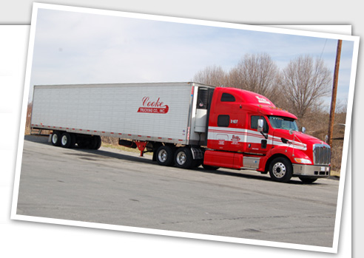
Applications of Centralized Structures
Small businesses often operate in a centralized manner simply because of the smaller size of their workforces
A small business owner may be the only manager in the entire company, with all other employees reporting directly to the owner. Organizational designs can change as small companies grow, however
Example
A trucking company is an example of a company with a centralized organizational design
Trucking company managers make all operational decisions, sending information to individual drivers through dispatchers

Slide 5
What is decentralization?
Decentralized organizations grant decision making authority to the managers of subunits.
Most firms are neither totally centralized nor totally decentralized

Slide 6
Applications of Decentralized Structures
Franchise organizations are good examples of a decentralized structure.
Product development and marketing decisions are taken by top management of franchise companies. The franchise owners are given full independence in running their individual stores.
Staffing decisions, working hours and compensation are decided by the franchise owners.
Example
Companies with a wide geographical reach also can benefit from a decentralized structure

Slide 7
Centralization and decentralization tendencies
Complete centralization (no organization structure)
Complete decentralization (no organization structure)
Authority delegated
Authority not delegated

Slide 8
Centralization and decentralization
More centralization
More decentralization
Environment is stable
Environment is complex, uncertain
Lower-level managers are not as capable or experience at making decisions as upper-level managers
Lower-level managers are capable and experience at making decisions
Lower-level managers do not want to have a say in decisions
Lower-level managers want a voice in decisions
Decisions are significant
Decisions are relatively minor
Organization is facing a crisis or the risk of company failure
Corporate culture is open to allowing managers to have a say in what happens
Company is large
Company is geographically dispersed
Effective implementation of company strategies depend on managers’ retaining say over what happens
Effective implementation of company strategies depends on managers having involvement and flexibility to make decisions

Slide 9
The structure of Centralization and decentralization
Bottom-to-top approach
Top-to-bottom approach
Level 1
Level 2
Level 3
Level 4
Decentralized approach
Centralized approach

Slide 10
The advantages decentralization over centralization
In decentralized organization the burden of Chief Executive is reduced, who has the entire burden of decision making in centralized organization.
When an organization grows, it becomes complex and becomes a challenge for top executives. These challenges can be easily faced in decentralized organization.
Decentralization avoids red-tapism in making decisions as it places responsibility for decision-making as near as possible to the place where action takes place
When authority is decentralized the subordinates get opportunities of taking initiative to develop managerial talents

Slide 11
ManagementStudyGuide.com
This is a DEMO Course On – Centralization and Decentralization.
Join MSG Premium Membership and Get Access to around 120 Courses + New courses added every week.
What You Get:
View All Courses Online.
Download Powerpoint Presentation for Each Course.
Do the Knowledge Checks for Each Course.

