Slide 1
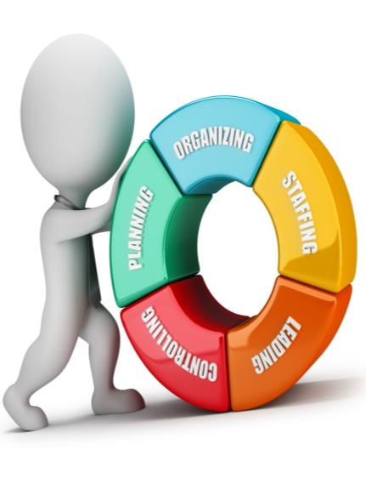
Planning
Staffing
Organizing
Directing
Controlling
Functions of Management

Slide 2
Course Objectives
List the Various Functions of Management
Explain the Planning Function of Management
Explain the Steps in Planning Function
List the Characteristics of Planning
Explain the Staffing Function of Management
Explain the Steps involved in Staffing Process
Explain the Steps in Manpower Planning
Explain the Steps of Employee Selection Process
Explain the Methods of Training
Describe the Methods of Employee Remuneration
Explain the Steps of Organizing Function Process
Describe the Principles of Organizing
List the Features of Controlling Function
Explain the Steps of the Controlling Process
List the Characteristics of Direction Function

Slide 3
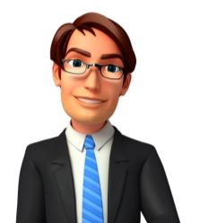
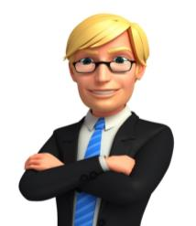
Introduction
Look at five people working in Perseus Inc. as described below.
Gavin Smith
Rachel Blake
Leo Cooper
Gloria Logan
Kyle Watson

Slide 4
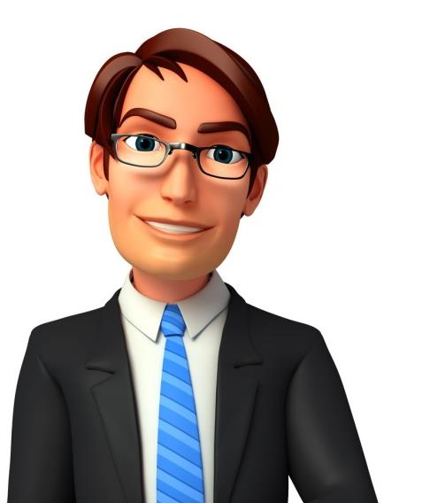
Introduction
Hi, I am Gavin Smith. I am a member of the Board of Directors at Perseus. I am one of the people in the organization who are responsible for laying down the objectives and broad policies of the organization. I also play a part in preparing the strategic plans and the preparation of department budgets, procedures, schedules etc. I am responsible for taking into consideration available and prospective human and physical resources of the organization so as to get effective co-ordination, contribution and perfect adjustment.

Slide 5
Introduction
Hi, I am Rachel Blake. I work as a Human Resources (HR) Manager at Perseus Inc. I am responsible for the managerial function of staffing which involves manning the organization structure through proper and effective selection, appraisal and development of the personnel to fill the roles assigned to the employers/workforce. I am responsible for motivating and identifying the training and development needs of the employees.

Slide 6
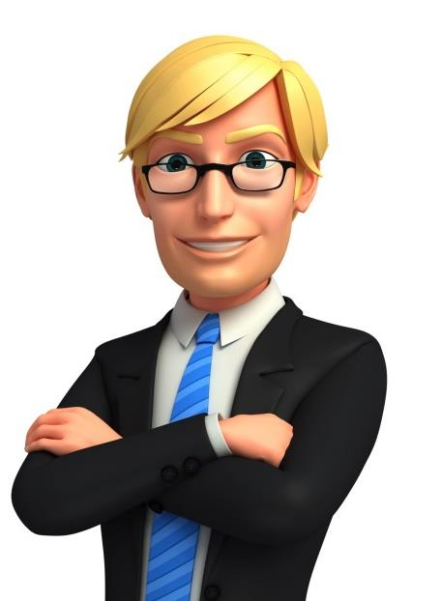
Introduction
Hello, I am Leo Cooper. I work as a Project Head in the Operations department at Perseus Inc. I am responsible for the execution of the plans of the organization in accordance with the policies and directives of the organization. I also take care of the coordination of the activities within my department. I am responsible for classifying the authority as well as for the co-ordination between authority and responsibility.

Slide 7
Introduction
Hello, I am Gloria Logan. I work as a Manager in the Operations department at Perseus Inc. I am responsible for the controlling function which includes verifying whether everything occurs in conformities with the plans adopted, instructions issued and principles established. I ensure that there is effective and efficient utilization of organizational resources so as to achieve the planned goals. I am responsible for measuring the deviation of actual performance from the standard performance, discovering the causes of such deviations and help in taking corrective actions.

Slide 8
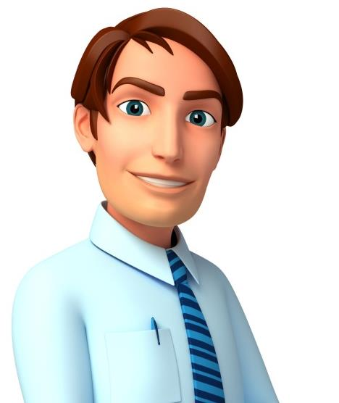
Introduction
Hi, my name is Kyle Watson. I am a supervisor at one of Perseus’ steel manufacturing plants. I am responsible for assigning of jobs and tasks to various workers at the plant. I guide and instruct the workers for day to day activities and am responsible for the quality as well as quantity of production. I ensure that discipline is maintained among the workers at the plant and communicate workers’ problems, suggestions and recommendatory actions to my managers.

Slide 9
Introduction
So, you can see that all the five people, Gavin, Rachel, Leo, Howard and Kyle help manage the functioning of Perseus’ business?
All the five of them perform managerial activities and functions to help in the smooth running of Perseus’ day-to-day business activities.
Gavin Smith
Rachel Blake
Leo Cooper
Gloria Logan
Kyle Watson
However, they are different from each other. How do you think their responsibilities differ from each other?

Slide 10
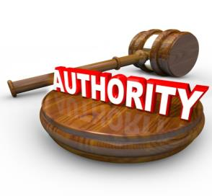
Introduction
Yes, each one has a different function to perform and a different chain of command that he controls; each one holds a different amount of authority and enjoys a different status in his managerial position at Perseus.
This difference between the three managerial positions and its functions at Perseus is due to the various ‘Functions of Management’.

Slide 11
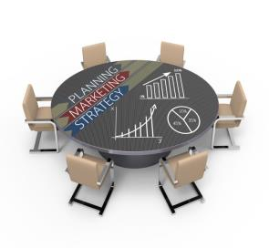
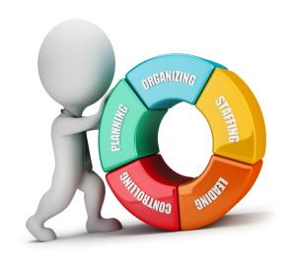
Introduction
The term ‘Functions of Management’ refers to a strict separation of the functions and the kinds of work performed by various positions in an organization.
The five key functions of management are: Planning, Staffing, Organizing, Controlling and Directing.

Slide 12
Introduction
Hence, to understand the management of any organization, it is very important to understand the different functions that are performed by management and how they contribute to the overall working of the organization.
Let us learn about ‘Functions of Management’ in detail.

Slide 13
Functions of Management
The following are the key Functions of Management:
Planning
Staffing
Directing
Organizing
Controlling

Slide 14
Planning as a Function of Management
Vision
Clarifies long term direction of a company [where the company is going] & reflects management’s aspirations for the company.
Objectives
Mission
Statement of the basic purpose for a company's existence & its values [role towards customers, employees, society, etc.].
Goals
Strategy
Strategy
Course of action created to achieve a long term goal.
Mission
Goals
Long term aims that a company / individual wants to achieve.
Objectives
Concrete attainments that can be achieved by following a certain number of steps.
Vision

Slide 15
Directing as a Function of Management
Components of Directing
Supervision
Supervision is directing efforts of employees and other resources to accomplish stated work outputs.
Supervision
Motivation
Motivation is something that moves the person to action, and continues him in the course of action already initiated / about to be initiated.
Components of
Directing
Leadership
Leadership is essentially a continuous process of influencing behaviour. A leader breathes life into the group and motivates it towards goals. The lukewarm desires for achievement are transformed into burning passion for accomplishment
Communication
Motivation
Communication
Communication is the transfer of information from one person to another by transmitting ideas, facts, thoughts, feelings & values. In its absence, organisation would cease to exist.
Leadership

Slide 16
ManagementStudyGuide.com
This is a DEMO Course On – Five Functions of Management.
Register Today and Get Access Complete Course for 184 Slides and many more courses on management and skills area.
What Do you Get:
View All Courses Online.
Download Powerpoint Presentation for Each Course.
Do the Knowledge Checks for Each Course.

