Slide 1
Performance Appraisals

Slide 2
Objective
Explain what is Performance Appraisal
Describe the purpose of Performance Appraisal
Define Goals and Work Efforts
Define Performance Criteria
Explain the steps in Performance Appraisal Process
Describe Who Should Do the Appraising
Explain the various methods of Performance Appraisal
Explain the importance of Appraisal Interview
Explain the Requirements of an Effective Appraisal System
Describe the errors of Performance Appraisal

Slide 3
Introduction
Yes, that’s true. But, he doesn’t have anything to show as far as work goes. You’re the best!
Of Course! They will! Did you forget ‘Performance Appraisals’?
It’s just that he is so good at impressing people. He is forever being sweet and nice and doing sweet talking.
Michael, I am hoping I get the promotion to the Senior Manager position that has opened in my department.
Who knows? Maybe they would choose Tom instead.
Oh yes! Now, I am feeling a lot better hearing that!
I hope they remember that he just sweet talks. I just hope they see that I am the one who has brought them their best projects.
Hey Chris, what happened? Why are you so tense?
Of Course! You will! Why not?
Why him of all the people?

Slide 4
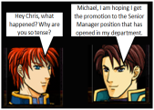
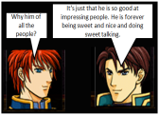
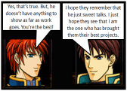
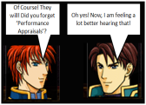
Introduction
What is Michael talking about? Why is Chris feeling better hearing about ‘Performance Appraisals’?

Slide 5
Introduction
Chris
‘Performance Appraisals’ will help Chris’s management to record and measure the performance of each of its employees
So, when the decision of choosing the new Senior Manager has to be taken, they can rely on the results of the ‘Performance Appraisals’ to choose the most suitable candidate
So, Chris feels better that during the ‘Performance Appraisals’, he will be able to clearly outshine Tom, as Chris is definitely a better performer than Tom
Let us learn more about ‘Performance Appraisals’

Slide 6
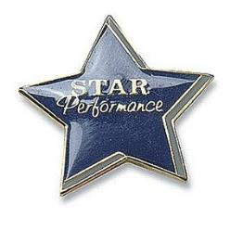
What is Performance Appraisal?
Performance Appraisal (PA) is the process which is used to evaluate the performance and potential of the employees in an organization.
It is a process of evaluating and communicating to an employee how he or she is performing the job and establishing a plan for improvement
Hence, it is a system of review and evaluation of job performance to assess accomplishments and to evolve plans for development

Slide 7
Purpose of Performance Appraisal
- For the Employee
Offers direction
Provides feedback about their performance
Provides inputs for improvement
Offers motivation for future level of effort and task direction
Clarifies task perception of the employee

Slide 8
Purpose of Performance Appraisal
- For the Organization/Management
Ensures proper documentation of performance
Offers Legal protection
Creates a motivation system
For decisions relating to promotions, firings, layoffs, and merit pay increases
Provides input for training and development needs

Slide 9
Performance Criteria
Performance criteria play a critical role in the job analysis-performance appraisal linkage
It is critical to define performance criteria as it is important to have a standard by which to compare “good” behaviour
Hence, you can see that ‘predictors’ are what a company looks for in an individual while hiring and ‘criteria’ is the “evidence” of a good employee
It is important to note here that there is always a gap observed between the theoretical or the ideal criteria versus the actual criteria

Slide 10
Steps in Appraisal Process
Setting & Communicating Performance Standards
Measuring Standards
Comparing Standards
Discussing Results
Taking Corrective Standards

Slide 11
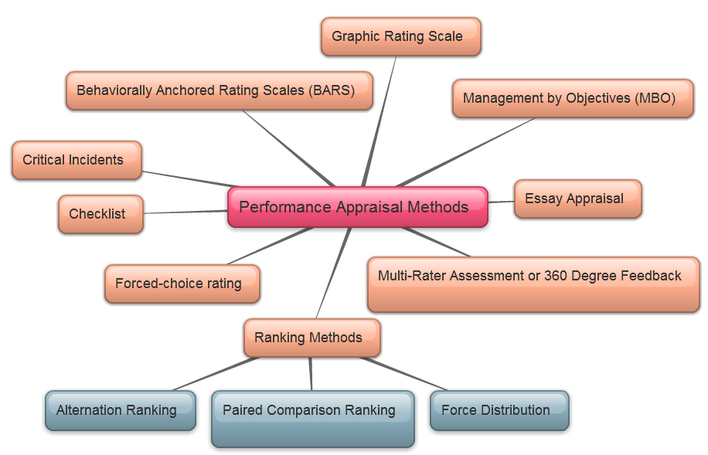
Performance Appraisal Methods
There are many formats or methods that are used to measure whether the performance criteria is met or not. Some of the methods used for performance appraisal are as follows:
Let us look at each one in detail

Slide 12
ManagementStudyGuide.com
This is a DEMO Course On – Performance Appraisal.
Join MSG Premium Membership and Get Access to around 120 Courses + New courses added every week.
What You Get:
View All Courses Online.
Download Powerpoint Presentation for Each Course.
Do the Knowledge Checks for Each Course.

