Slide 1
PERFORMANCE
Improving Employee Performance

Slide 2
Introduction
Shane Zydus has been working in Lithium Education Inc. for the past seven years.
Presently, Shane is a Project Manager and heads a team of five Instructional Designers and Senior Instructional Designers.
Shane Zydus

Slide 3
Introduction
Let’s meet Shane’s team.
Samuel
Roxette
Liam
Catherine
Ashley
Shane Zydus

Slide 4
Introduction
Hey there! I am Samuel!
RESUME
I am a Senior Instructional Designer with about six years of experience.
Name: Samuel
Designation: Senior Instructional Designer
I have extensive experience working on game-based learning as well as gamification of learning courses.
Samuel is a Senior Instructional Designer and has about six years of experience. He has extensive experience working on game-based learning as well as gamification of learning courses. He is adept in working across different domains. He loves the challenge of learning new things in his job.
I am also adept in working across different domains.
I love the challenge of learning new things in my job.

Slide 5
Introduction
Every project is completed with mediocre quality and just about okay customer satisfaction but never customer delight.
Hence, as you can understand the individual performance levels affect not only the employee but also the team as well as the organization as a whole.
Shane Zydus

Slide 6
Introduction
So, it is crucial that an employee as well as his Manager should strive to improve the employee’s performance levels to its maximum possible capability. Let us learn about ‘Improving Employee Performance’ in detail.
Shane Zydus

Slide 7
Objectives
Explain the Importance of Employee Performance
Explain Relevance of Knowledge, Skills, & Abilities
List the Reasons of Poor Employee Performance
Explain Considerations for Performance Objectives
Explain the Types of Performance Objectives
Describe Possible Performance Measures
Describe How to Measure Employee Performance
List the Traits Affecting Employee Performance
Explain the Tools for Gathering Performance Feedback
Explain Questions to Improve Employee Performance
Explain the Strategies for Improving Employee Performance
Describe the Types of Competencies Affecting Performance
Describe Competency Systems Driving Performance
Explain How to Use Training for Improving Performance
Explain Performance Improvement Plans/Programs (PIPs)

Slide 8
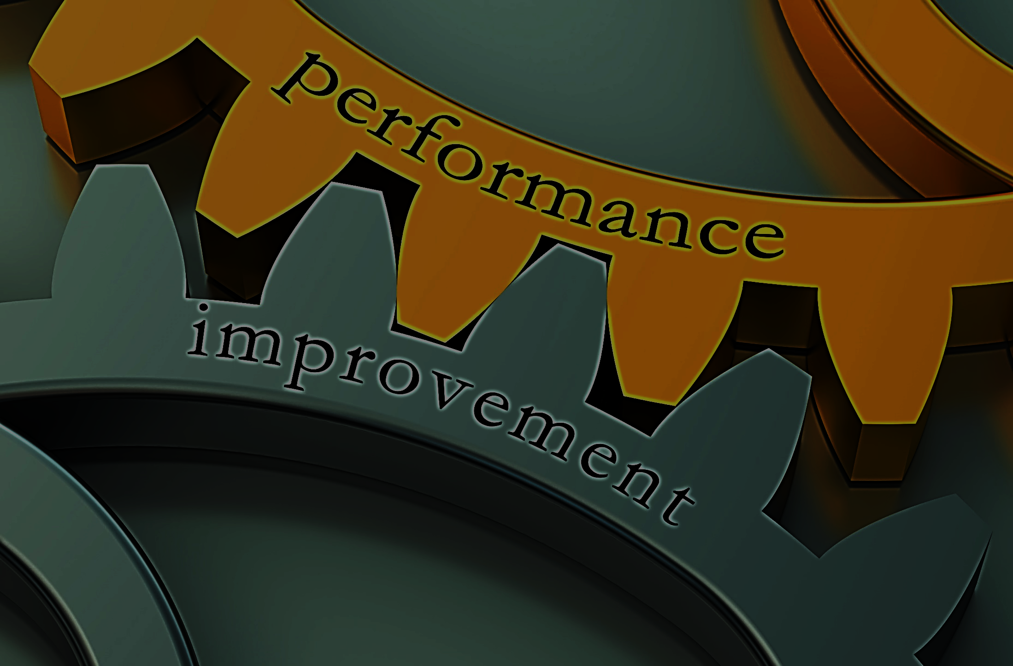
Reasons of Poor Employee Performance
Unfamiliarity with equipment or process
Personal problems
Lack of time
Substance abuse
Lack of skills & ability
Poor work ethic
Poor peer relationships
Low motivation

Slide 9
Types of Competencies Affecting Performance
The five types of competencies affecting performance are:
Motives
Motives
Motives
Traits
Motives:
Things about which a person consistently thinks about or wants and that which causes action.
Motives drive, direct, or select behaviour towards certain actions or goals or away from others.
Self-concept
Motives
Knowledge
Skill
Let us look at each in detail.

Slide 10
ManagementStudyGuide.com
This is a DEMO Course On:
Improving Employee Performance
Subscribe Today and Get Access to Unlimited Courses.
What You Get:
Access the Courses Online.
Download Powerpoint Presentation for Each Course.
Get Certificates.

