Slide 1
20%
25%
75%
15%
55%
25%
45%
Basics of Statistics

Slide 2
Objectives
Explain What is Statistics
Describe the Uses of Statistics
Explain the Types of Variables
Explain the Major Sources of Data
Explain the Key Terms of Statistics
Explain the Steps for Presentation of Data
Explain the Various Measures of Central Tendency
Explain the Methods of Graphical Presentation of Data
Explain What is a Frequency Distribution Table
Explain What is Probability
Explain What is Combination
Explain What is Permutation
Explain What is Variance
Explain What is Standard Deviation
Describe the Types of Discrete Distributions

Slide 3
Introduction
Liu Chang works as a team leader in the Learning & Development (L&D) Department at Helios Inc.
In his recent appraisals, Liu has been promoted as the Assistant Manager.

Slide 4
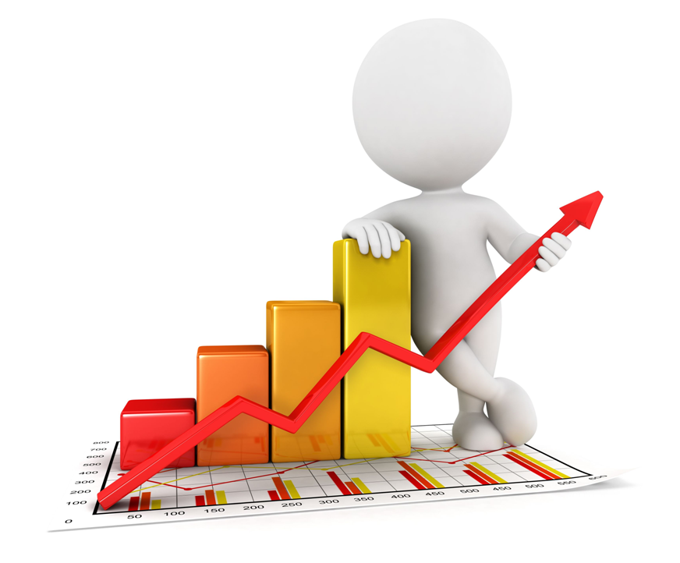
Introduction
Therefore, the main focus of Liu in his new role would be to collect and analyze data regarding the various skills of employees, their areas of improvement, areas where they need to develop new skill sets etc.

Slide 5
Introduction
Liu found that in his new role, he is constantly required to analyze large amounts of data.
He has assigned one of his subordinates, Kate to collect various data related to his queries.
However, Liu found that when Kate collected the data and collated it all in the form of graphs, Liu was just not able to understand the data.

Slide 6
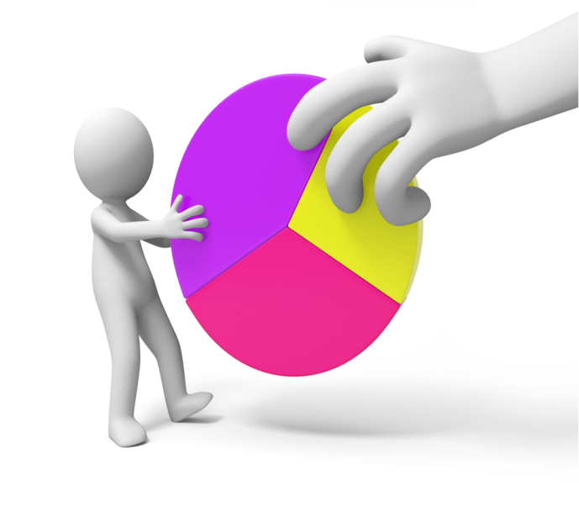
Introduction
Kate collected the data and represented it in the form of a pie-chart so that Liu could analyze and interpret the data at a glance.
However, Liu could not understand the pie-chart and interpret it.

Slide 7
Introduction
Instead he chose to go through almost 20 pages of data that Kate had collected for the purpose.
Yet, Liu could not make any sense of all the 20 pages.
This was because he could not see the complete data in a snapshot as was shown by the pie-chart.

Slide 8
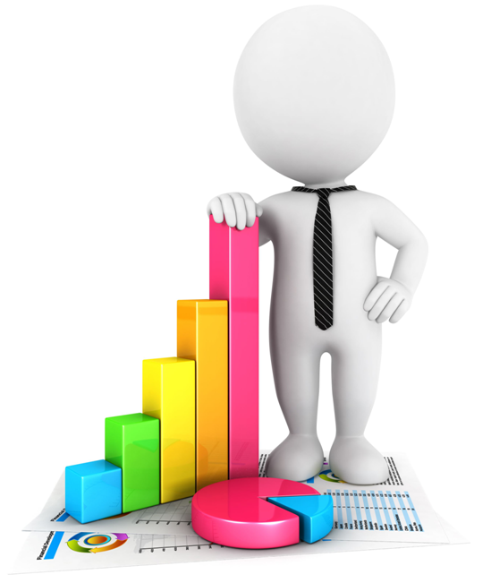
Introduction
Hence, Liu understood that it was important for him to learn and understand Statistics to succeed in his new role.
Statistics is the branch of applied mathematics that is concerned with the collection, organization, analysis, interpretation and presentation of quantitative data.

Slide 9
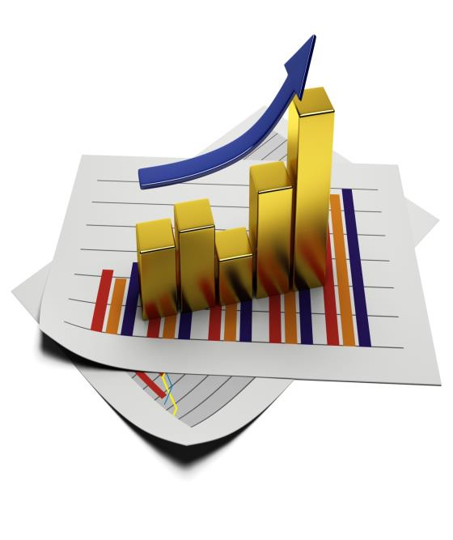
Introduction
Therefore, you can understand that it is crucial that you have a good grasp of statistics to succeed in the corporate world. This is because in any organization, almost all information is represented in the form of data that is communicated through reports. Large chunks of such quantitative data is collected, organized and presented using statistics in a concise form to help people analyze and interpret the data for their purposes.
Let us learn about ‘Basics of Statistics’ in detail.

Slide 10
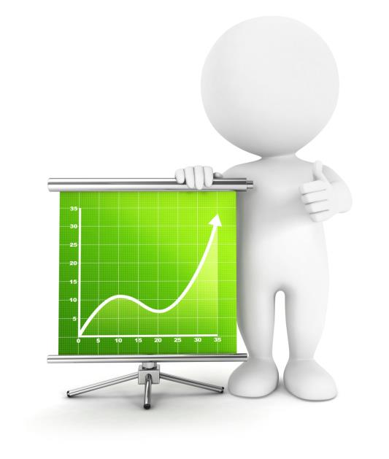
What is Statistics?
Statistics is the branch of applied mathematics that is concerned with the collection, organization, analysis, interpretation and presentation of quantitative data.
The data required for statistics is collected through surveys and experiments and statistics also deals with the planning of data collection.

Slide 11
Uses of Statistics
Statistics is a very important branch of mathematics and it has several uses such as follows:
It helps in gaining a better understanding of a phenomenon of nature.
It helps in capturing and getting the exact description of a phenomenon of nature.
In any field of study, statistics helps in conducting in a proper organized and efficient planning of a statistical inquiry.

Slide 12
Types of Variables
Variables can be classified as follows:
Types of Variables
Qualitative Variables
Quantitative Variables
Discrete Random Variables
Continuous Random Variables
Let us look at each in detail.

Slide 13
Major Sources of Data
There are two main sources of data for collecting information for statistical experiments such as follows:
•
Primary Data
‘Primary Data’ is the data that is collected for the first time during the research.
•
Secondary Data
‘Secondary Data’ is the data which is already available and published data that had been collected for some other purpose, but can be used for the present research also.

Slide 14
Steps for Presentation of Data
The following are the steps involved in presentation of data:
Classification of Data
Step
1
Step
2
Tabulation of Data
Frequency Distribution of Data
Step
3
Diagrammatic Presentation of Data
Step
4
Graphic Representation of Data
Step
5
Let us look at each in detail.

Slide 15
Methods of Graphical Presentation of Data
There are various kinds of graphs that can be used for presenting the data in a graphical form. Some of the most commonly used graphs in statistics for presenting the data graphically are as follows:
Histogram
Pie Chart
Bar Graph/Bar Chart
Frequency Polygons
Line Graph
Scatter Chart/Scatter Diagrams/Dot Plot
Ogive
Venn Diagram
Stem-and-leaf Plots
Box-and-whisker Plots/Box Plots
Let’s look at each in detail.

Slide 16
ManagementStudyGuide.com
This is a DEMO Course On – Basics of Statistics.
Join MSG Premium Membership and Get Access to around 120 Courses + New courses added every week.
What You Get:
View All Courses Online.
Download Powerpoint Presentation for Each Course.
Do the Knowledge Checks for Each Course.

