Slide 1
TRUST
MOTIVATION
CONFIDENCE
SERVICE
UNDERSTANDING
LOYALTY
HAPPINESS
PARTNERSHIP
SUPPORT
SATISFACTION
C
U
S
T
O
M
E
R
Retention Strategies

Slide 2
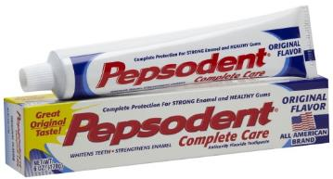
Introduction
Hazel always uses ‘Pepsodent’ toothpaste, L’Oreal shampoo and Revlon brand of cosmetics.
Let us look at a few brands that she uses.
Brands
This is Hazel Watson.

Slide 3
Introduction
Now, she is happy with these brands and so has continued using them for several years.
She must have carefully considered all her options and then decided to go ahead with using these brands.
Now, think of the first time when she decided to start using these brands.

Slide 4
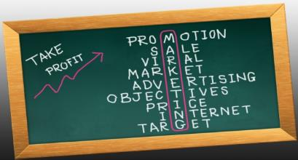
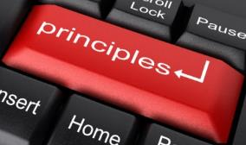
Introduction
This is where the concept of ‘customer retention’ and various strategies related to it come into the picture and are crucial to any company’s success.
One of the key principles in sales is
that, it is better to keep an existing
customer happy and prevent him
from going to your competitor brands rather than depending solely on making new customers.
Let us learn about customer retention and various customer retention strategies in detail.

Slide 5
Objective
Explain What is Customer Retention
Explain What is Customer Loyalty
Describe the Drivers of Customer Loyalty
Describe the Various Customer Loyalty Breakers
Explain What is Customer Satisfaction
Explain Attrition and Silent Attrition
Describe the Various Customer Retention Strategies
Explain the Determinants of Customer Retention
Explain Methods and Tools for Customer Retention
Explain Principles of Retention Management
Explain What is Customer Lifetime Value (CLV)
Explain the Need of Relationship with Customers
Explain How to Use Strategic CRM for Retention
Explain the Myths of Customer Retention
List the Challenges of Customer Retention

Slide 6
What is Customer Retention?
Customer retention is a strategic process to retain existing customers. It is difficult to exactly define customer retention as it is a variable process. A basic definition could be ‘customer retention is the process when customers continue to buy products and services within a determined time period’. However this definition is not applicable for most of the high end and low purchase frequency products as each and every product is not purchased by the customer.

Slide 7
Drivers of Customer Loyalty
It is very important for an organization to identify the factors and facets which drive customer loyalty. These factors help the organization to manage customer loyalty in a better and efficient way. Following are the drivers of customer loyalty:
Attitude
Technology
Drivers of Customer Loyalty
Product and Services
Human Resources
Supplier’s Culture
Let us look at each in detail.

Slide 8
Need of Relationship with Customers
Building relationship with customers in current market trends is the most important aspect that an organization should focus on for customer retention. The following are some of the substantial outcomes of building a long-term relationship with the customer:
Growth in
Revenue
Chances of Getting
Referrals
Cost to Serve is
Low
Leads to Customer
Retention
Leads to Customer
Loyalty
Leads to Customer
Satisfaction
Better Customer Perceptiveness
Let’s look at each in detail.

Slide 9
Strategic CRM for Long Term Relationship with Customers
Determining and development of CRM strategies involves following steps:
1
2
3
Amplify Commitment
Building a Valuable Project Team
Requirement Analysis
Let us look at each in detail.

Slide 10
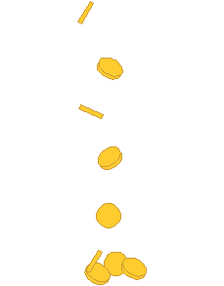
Myths about Customer Retention
Customer retention is a crucial factor for organizational success in business. Many companies have misconceptions about customer retention in regard to assessing customer satisfaction in order to enhance business. Following are the most prominent myths about customer retention in the business world:
100 %
Customer
Retention
An organization should endeavor a perfect 100 % customer retention
Enhancing customer retention and enhancing organizational profit is equivalent

Slide 11
ManagementStudyGuide.com
This is a DEMO Course On – Customer Retention Strategies
Subscribe Today and Get Access to 250+ Course Presentations.
What You Get:
Access the Courses Online.
Download Powerpoint Presentation for Each Course.
Get Certificates.

