Slide 1


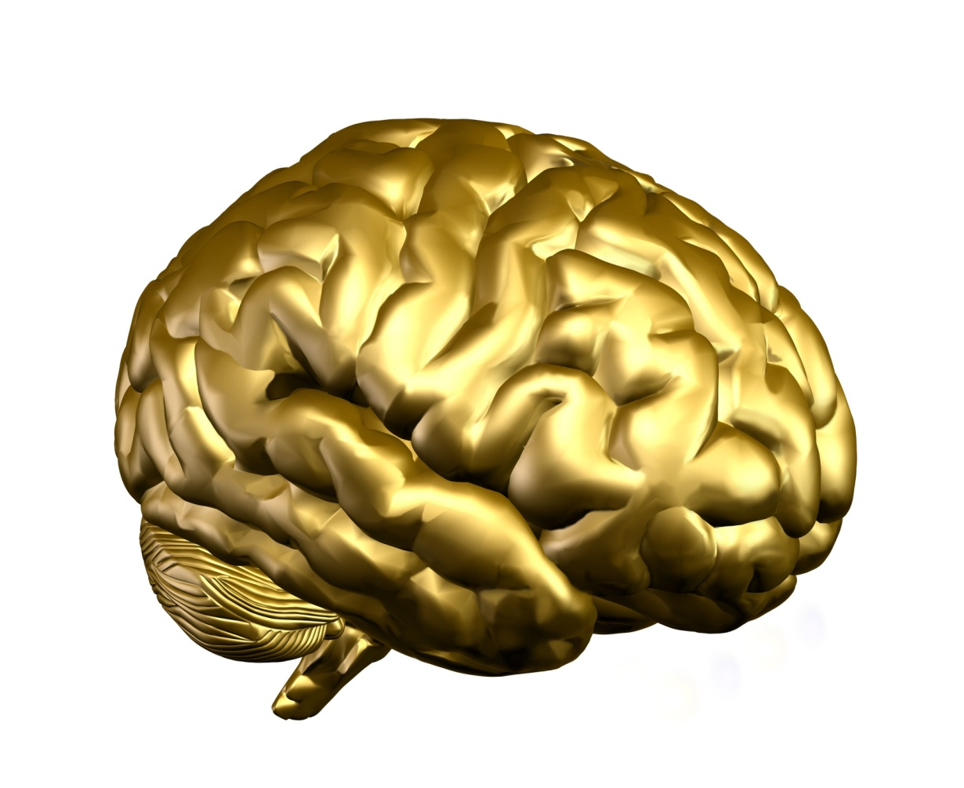

Emotional Intelligence

Slide 2




Course Objectives
Define Emotional Intelligence
Describe the History of Emotional Intelligence
Explain What is Emotional Intelligence (EQ)
List the Benefits of Emotional Intelligence
Explain the Relation between Emotions and Brain
Explain the Stages of Emotional Hijack
Explain Categorization of People
Differentiate between High IQ and High EQ
Explain the Importance of EI at Workplace
Explain the Competencies of Emotional Intelligence
Explain the Ways to Boost Self Confidence
Explain Ways to have Effective Group Interactions
List the Characteristics of High and Low EI
Explain the Principles of Building Your EQ
Describe the Measures of Emotional Intelligence

Slide 3



Introduction
Helen Annikov works as the Vice President (Human Resources) at Fortune Inc. She had been working with Kingship Inc. previously, a competitor of Fortune.

Slide 4

Introduction
Helen notices that though the leaders at Fortune are intelligent and experienced, they have failed to make any considerable enhancements to the performance and motivation levels of the employees at Fortune.

Slide 5
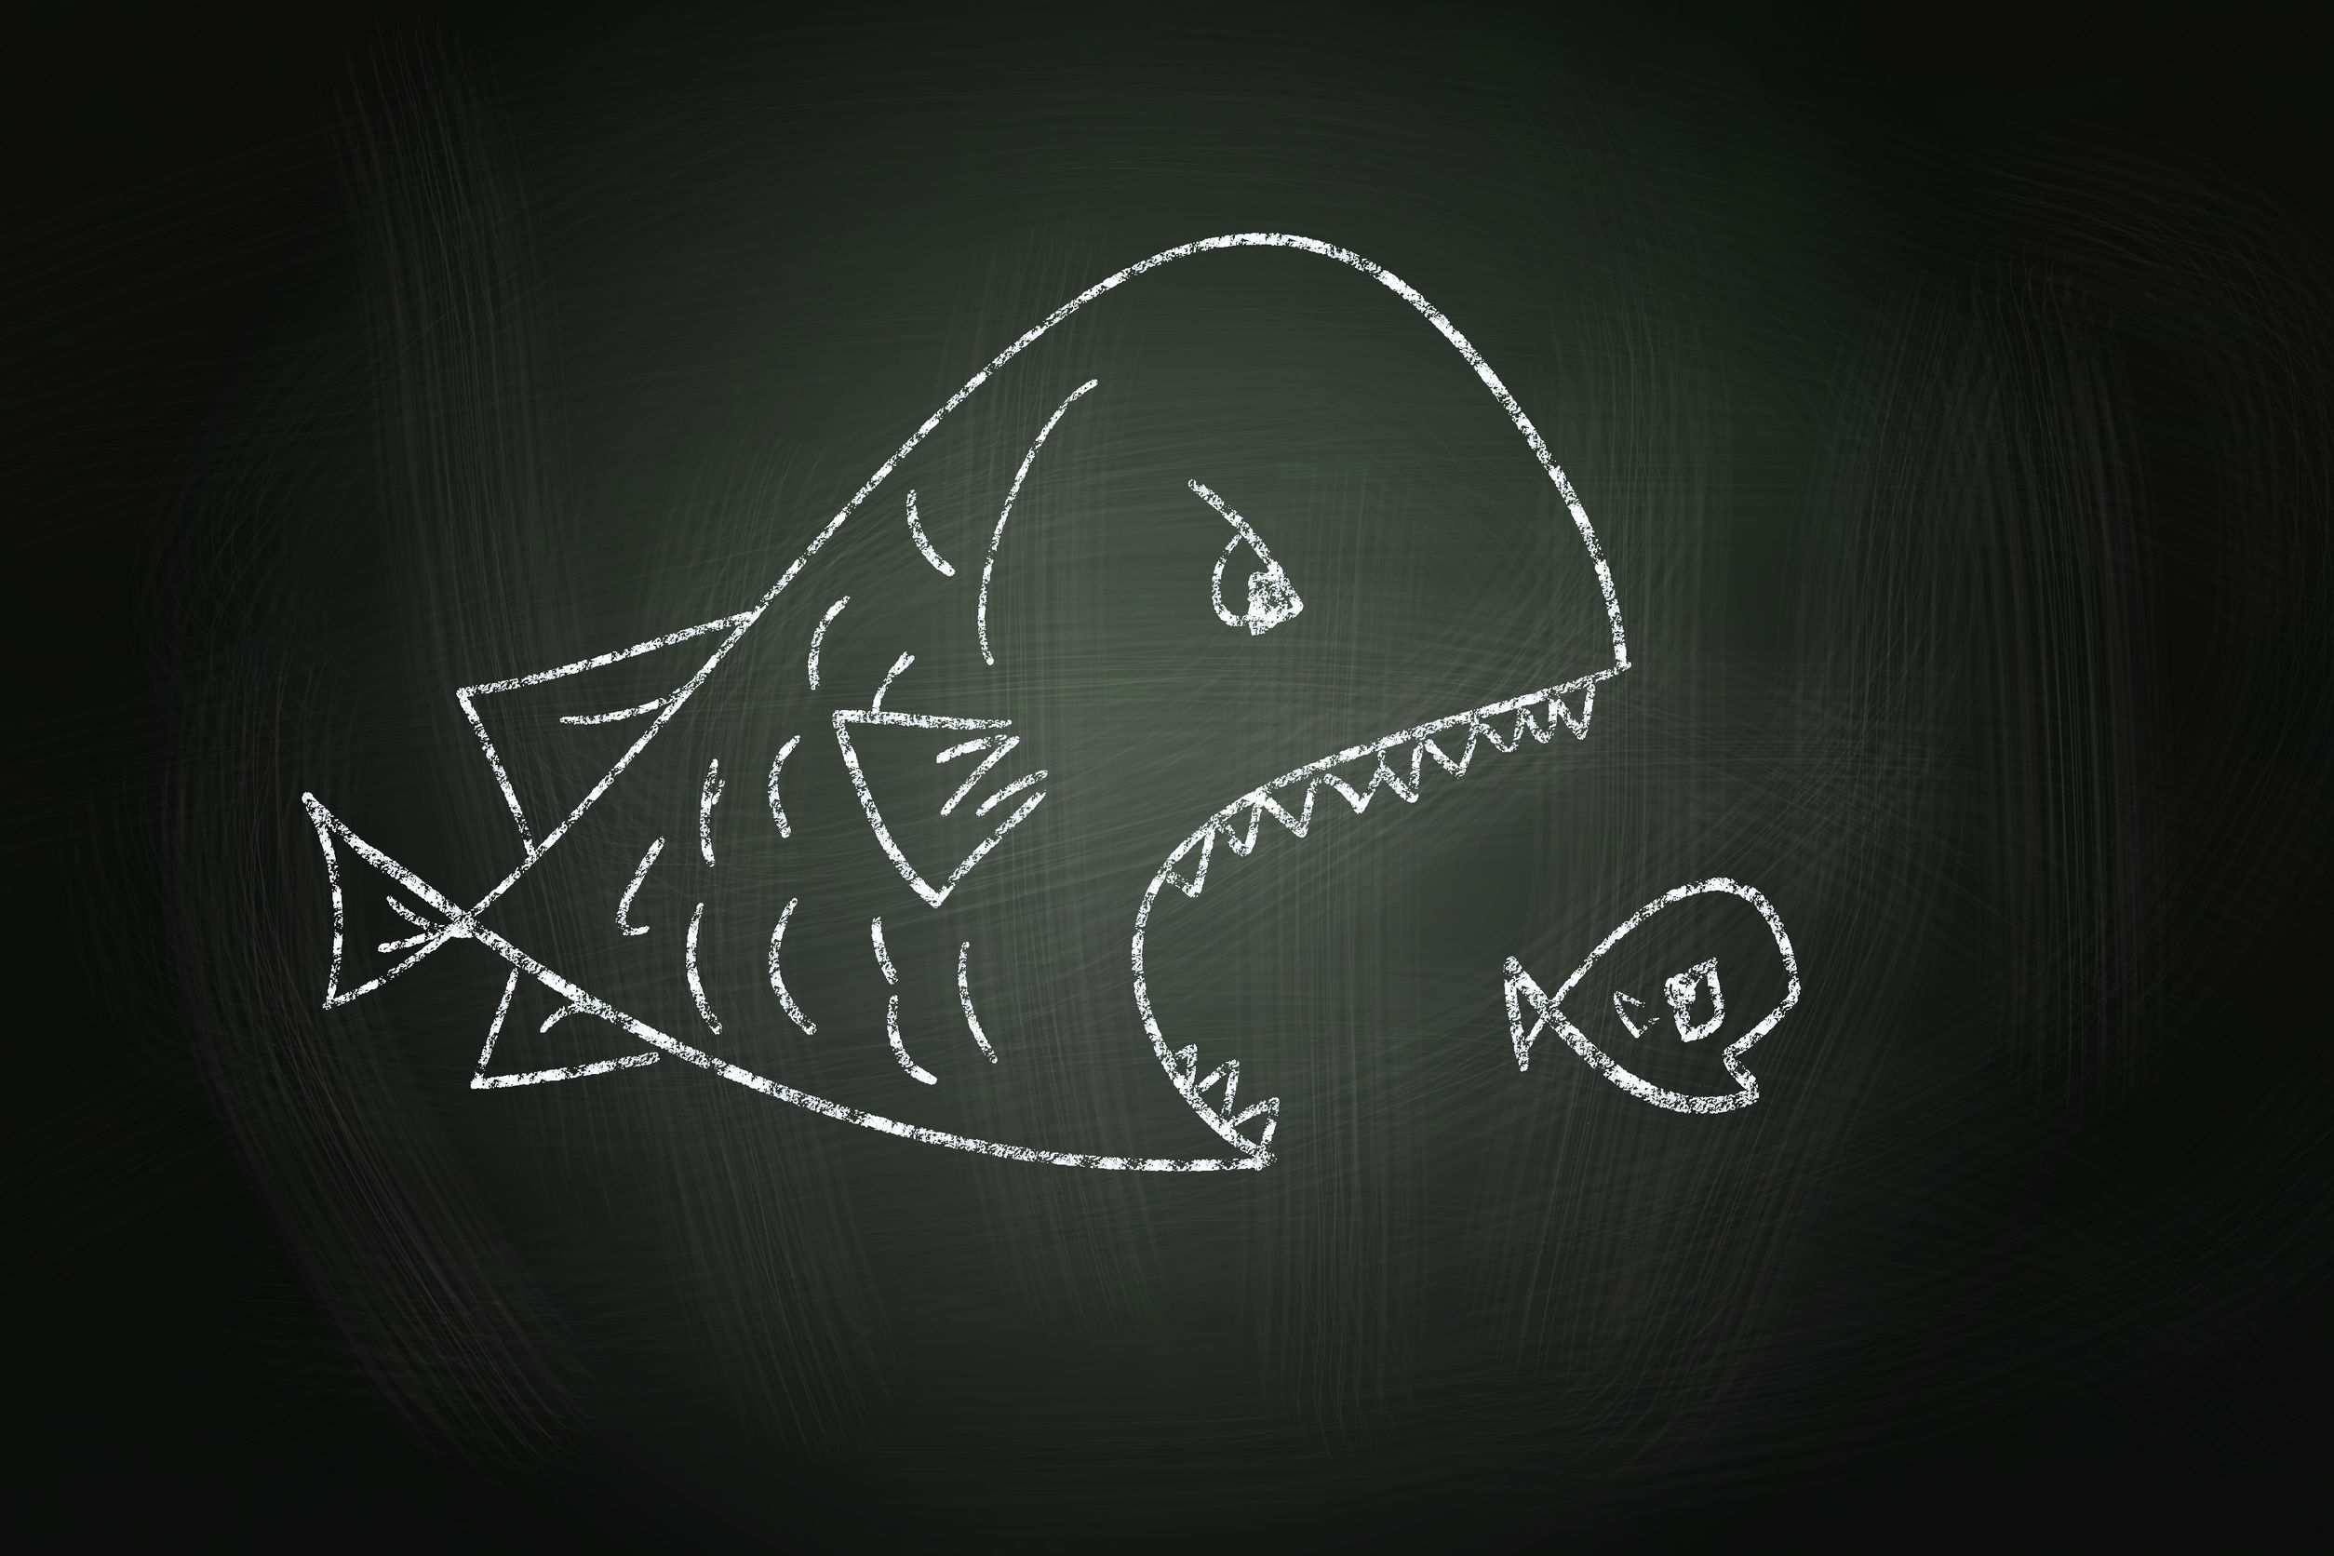
Introduction
Despite of having intelligent and bright leaders as well as employees, Fortune is lagging behind several of its competitors including Kingship Inc. Fortune has a horde of employees together with its leaders who have an impressive work profile and academic background. However, Fortune still suffers from good performance levels and the employees lack motivation. Employees also do not share a good rapport with each other and their leaders.

Slide 6
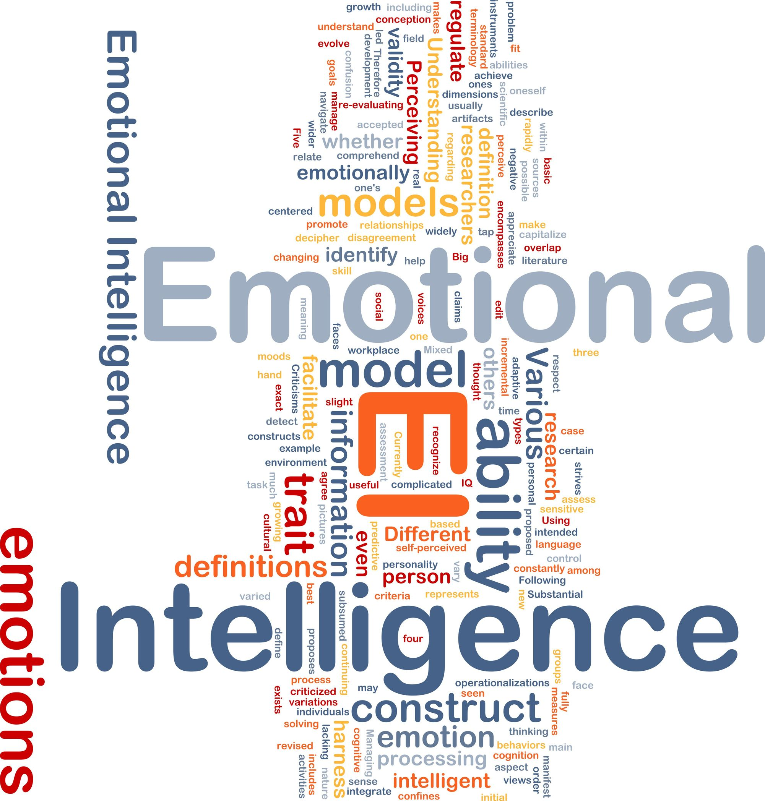
Introduction
So, Helen starts analyzing the root cause for Fortune’s issues. She finds that though the leaders and employees at Fortune are skilled and talented, the major problem with them was that they had not been selected after being checked for their EQ or Emotional Quotient which measures their Emotional Intelligence levels.

Slide 7

Introduction
Helen decides that from now onwards, any candidate that is interviewed for a position at Fortune would need to undergo an ‘Emotional Intelligence’ test. This ‘Emotional Intelligence’ test would check the EQ levels of the candidate and show how Emotional Intelligence level of the candidate.

Slide 8

Introduction
‘Emotional Intelligence’ is concerned with understanding of oneself and others, relating to people, and adapting to and coping with the immediate surroundings and addresses the emotional, personal, social, and survival dimensions of intelligence.

Slide 9

Introduction
Therefore, you can understand that ‘Emotional Intelligence’ plays a crucial role in the personal as well as professional success of a person.
Let us learn about ‘Emotional Intelligence’ in detail.

Slide 10

Definition
Goleman defined ‘Emotional Intelligence’ in 1998 as follows:
“Emotional Intelligence refers to the capacity for recognizing our own feelings and those of others, for motivating ourselves and for managing emotions well in ourselves and our relationships.”
(Goleman, 1998)

Slide 11

History of Emotional Intelligence
The given timeline shows the history and development of the various concepts of Emotional Intelligence over the last 100 years.
First large scale administration of IQ tests to US Army recruits
Wechsler's
'Non-intellective' Intelligence
1900
1918
1930
1940
1950
IQ Alfred Binet begins administering of IQ tests to French schoolchildren for testing intelligence
Thorndike’s Social Intelligence
Ohio State studies 'task' versus 'consideration'

Slide 12

What is Emotional Intelligence (EQ)?
‘Emotional Intelligence’ is about being honest, being aware of one’s own feeling, being aware of the other’s feelings and about being smart with one’s emotions.

Slide 13

Benefits of Emotional Intelligence
Higher levels of emotional intelligence can contribute to a better performance in several areas such as:
Straightforwardness and Composure
Improved Communication
Building Employee Relationships
Persistence in Achieving Set Goals
Effective Decision Making

Slide 14

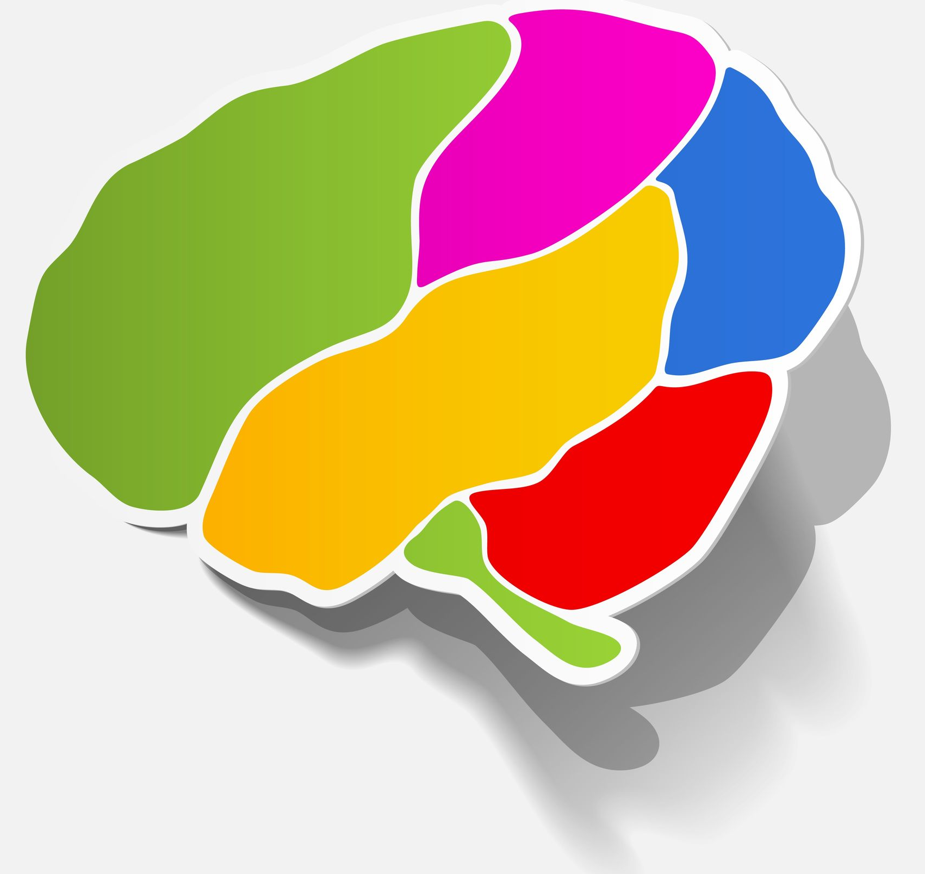
Importance of Emotions in Humans
Many researchers including Darwin have carried out several meaningful studies on ‘human emotions’.
Darwin proposed that human emotions or simply emotions play an important role in human life.
Emotions serve a biological purpose as they signal to us when there is something wrong or when our needs are not getting met.

Slide 15
Stages of Emotional Hijack
Stage 3:
Reacting Automatically:
Reacting Automatically:
  The third stage of an ‘emotional hijack’ is the automatic reaction that makes you respond automatically based on the trigger and the strong emotion you felt.
  Mostly, such automatic reaction may make you regret your reaction later.
  This is because it is not thought of and decided prior to reacting and may have a negative effect on you and others.
Stage 4
Stage 1
Emotional Hijack
Stage 3
Stage 2

Slide 16


Hostile Aggressive People
Hostile Aggressive People
The people in this category have a general feeling of hostility towards other people and openly voice their opinions in an aggressive manner.
The best way to deal with people of this category is to give them the space and time to voice and express their opinions openly and clearly.
After you have let them vent out their opinions, you can then move onto solving the problem by asking for their cooperation and keeping them in the loop.

Slide 17


Derailment
Derailment:
High Emotional Intelligence can be greatly useful to prevent the derailment or total collapse of one’s career.
A study conducted by the Center for Creative Leadership found that a majority of the executives who faced derailment or total collapse of their career displayed certain common traits.
These traits were extreme rigidity in dealing with people, poor relationships with their team members and the inability to lead teams.

Slide 18
Competencies of Emotional Intelligence
The given flowchart shows the various competencies of ‘Emotional Intelligence’.
Emotional Intelligence
Personal Competence
Emotional Competence
Social Competence
Self Awareness
Self Management
Social Awareness
Relationship Management
Emotional Self-awareness
Accurate Self –assessment
Self-confidence
Emotional Self-control
Transparency
Adaptability
Achievement Orientation
Initiative
Optimism
Empathy
Organizational Awareness
Service Orientation
Developing Others
Inspirational Leadership
Change Catalyst
Influence
Conflict Management
Teamwork and Collaboration

Slide 19
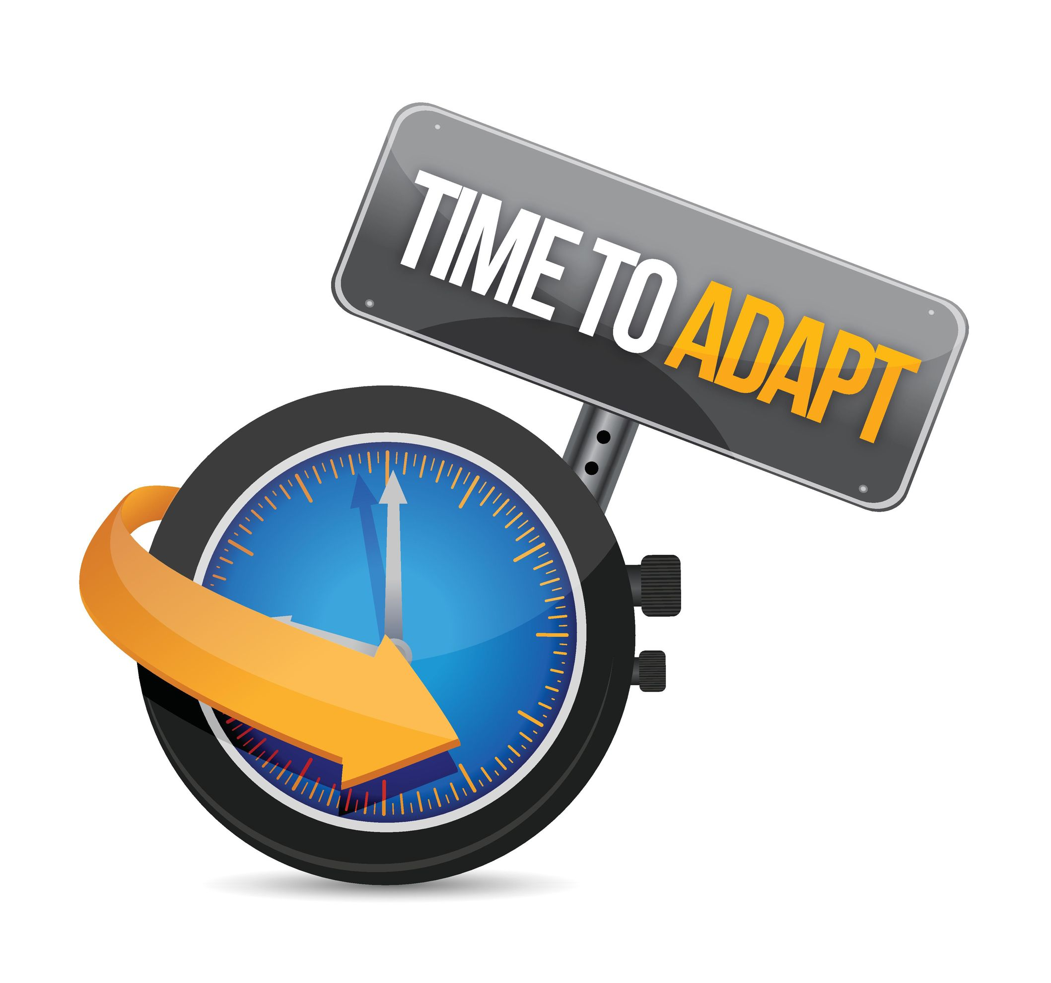
Adaptability
Self Management
Self-management means managing one's internal states, impulses and resources.
Self Management Competencies are:
Emotional Self-control
Transparency
Adaptability
Adaptability
Achievement Orientation
Initiative
‘Adaptability’ means demonstrating flexibility in adapting to changing situations or overcoming obstacles.
Optimism

Slide 20

Empathy
Social Awareness
‘Social Awareness’ means the awareness of others’ feelings, needs and concerns.
Social Awareness Competencies are:
Empathy
Empathy
Organizational Awareness
‘Empathy’ means sensing others’ emotions, understanding their perspectives, and taking active interest in their concerns. Hence, ‘empathy’ means ‘fellow feeling’ and understanding and entering into another's feelings.
Service Orientation

Slide 21

Advantages of Effective Group Interactions
1
4
7
Supplement to formal channel:
Group interactions serve as a supplement to the formal channel of communication. It also serves as a supplement in those cases where formal communication does not work.
Speedy spread of information
Provides emotional support
Psychological satisfaction
2
5
8
Receipt of fast feedback
Free expression of ideas
Builds relationships
3
6
9
Sense of unity
Supplement to formal channel
Creates ideas

Slide 22

Characteristics of Low EI
The following are the characteristic feelings of people with a low level of El:
Feelings of Guilt
Greater Frustration with Others
Greater Feeling of Inner Emptiness

Slide 23
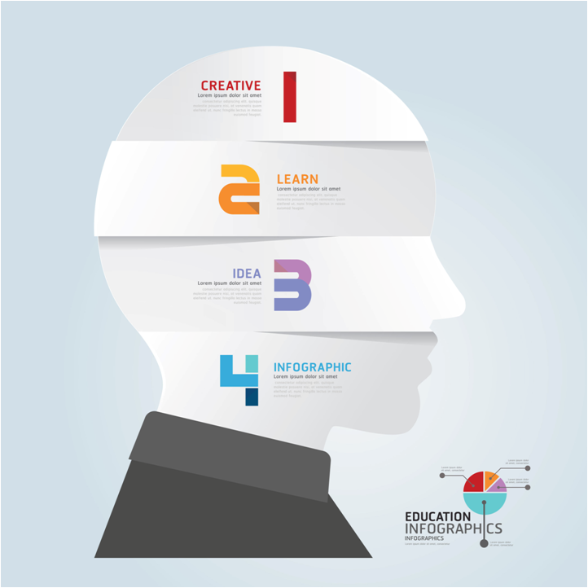


Real Life Example
John is well-known in his organization as a good leader and amicable person.
He is known to have great rapport with both his subordinates as well as his seniors.
He leads his team with great diligence and care and is an understanding boss.
An EQ test was conducted by the Human Resources department on all the employees of Patterson Inc. to understand the need for any kind of training and development programs for people with low EQ.

Slide 24

Emotional Competence Inventory (ECI)
There are several methods that are used for measuring Emotional Intelligence such as follows:
Bar-on Emotional
Intelligence
The Emotional Competence Inventory (ECI) was developed by Richard Boyatzis and Daniel Goleman. The ECI is published by the Hay Group (www.haygroup.com) which licenses the test to accredited administrators. The Emotional Competence Inventory (ECI) consists of a 72-item, 360-degree online feedback instrument. It has the capability of generating a report that gives details of scores by self, peers, and managers based on Goleman’s 18 competencies. Hence, it is a system of Emotional Competence Inventory with 360 Degree Evaluation. Each of the listed competencies can be strength, a hidden asset, a known development need, or a blind spot for the individual being tested. Also, the test has the provision of a comments section where each evaluator can add relevant comments that are posted as anonymous comments.
Work Profile
Questionnaire
On-line Tests of EQ
Mayer-Salovey-Caruso
Emotional Intelligence
Test (MSCEIT)
Multifactor Emotional
Intelligence
Scale (MEIS)
Emotional Competence Inventory
(ECI)
Let’s look at each in detail.

Slide 25

ManagementStudyGuide.com
This is a DEMO Course On – Emotional Intelligence.
Register Today and Get Access to 5 FREE Courses.
What Do you Get:
View All Courses Online.
Download Powerpoint Presentation for Each Course.
Do the Knowledge Checks for Each Course.

