Slide 1
Open Area
Blind Area
Johari Window
Hidden Area
Unknown Area

Slide 2
Course Objective
Describe the History of Johari Window
Explain What is the Johari Window
Explain the Quadrants of the Johari Window
Explain the Identification of Individual Types from Johari Window
Explain the Ideal Shape of Johari Window
Describe the Johari Window for a New Team Member
Describe Johari Window for Established Team Member
List the Uses of Johari Window

Slide 3
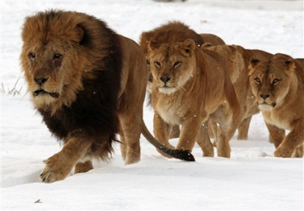
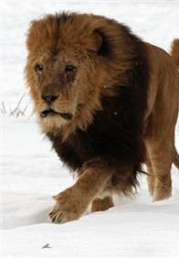
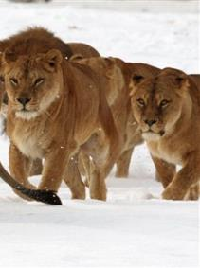
Introduction
Have you ever seen the lion that leads his pride?
The leader is strong and dependable. All the other lions in the pride feel protected by him and trust him.
So, why is the quality of ‘trust’ important in a leader?
The leader is strong and dependable.
All the other lions in the pride feel protected by him and trust him.

Slide 4
Introduction
When a subordinate trusts his superior, he feels motivated to work under his leadership. He feels safe under his trusted leader’s guidance and feels like following in the leader’s footsteps.
Trusting the leader also helps the member to believe in the integrity of the leader. He believes that his leader will lead with truth and righteousness.
It is very important that the members of the team or the subordinates trust their leader.

Slide 5
Introduction
So, how can we build trust among the members of our team?
When a subordinate trusts his superior, he feels motivated to work under his leadership. He feels safe under his trusted leader’s guidance and feels like following in the leader’s footsteps.
There is a model known as the ‘Johari Window’ which stresses on the importance of feedback and disclosure to build trust.
Trusting the leader also helps the member to believe in the integrity of the leader. He believes that his leader will lead with truth and righteousness.
It is very important that the members of the team or the subordinates trust their leader.

Slide 6
Introduction
‘Johari Window’ is an effective technique which when used appropriately provides valuable information regarding one’s own self and others, which is an important characteristic which every leader needs to possess to succeed.
When a subordinate trusts his superior, he feels motivated to work under his leadership. He feels safe under his trusted leader’s guidance and feels like following in the leader’s footsteps.
Trusting the leader also helps the member to believe in the integrity of the leader. He believes that his leader will lead with truth and righteousness.
It is very important that the members of the team or the subordinates trust their leader.
Let’s learn about ‘Johari Window’ in detail.

Slide 7
History of Johari Window
•
•
•
In 1955, Joseph Luft and Harry Ingham, two American psychologists developed a model called the ‘Johari Window’.
‘Johari Window’ is a model for self-awareness, personal development, group development and understanding relationship.
They called the model ‘Johari Window’ after combining their first names, ‘Joe’ and ‘Harry’.

Slide 8
What is the Johari Window?
The ‘Johari Window’ is a simple and useful tool for understanding and training self-awareness, group dynamics, personal development, interpersonal relationships, improving communications between people, team development and intergroup relationships.
It is a very useful tool especially so because it lays emphasis on and influences 'soft' skills, behavior, cooperation, inter-group development, empathy and interpersonal development.

Slide 9
The Johari Window
The ‘Johari Window’ is based on a four-square grid.
The ‘Johari Window’ is made up of a window with four 'panes’.
1
2
1
2
The window is a square pane with a cross in the middle of it.
3
4
3
4
This cross divides the window into four panes.

Slide 10
The Johari Window
Each pane represents two things – stuff known to you and stuff known to others.
Self
Known
Unknown
The four panes of the ‘Johari Window’ are called 'regions' or 'areas' or 'quadrants'.
'Regions' / 'Areas' / 'Quadrants'
'Regions' / 'Areas' / 'Quadrants'
Known
Each contains and represents the information - feelings, motivation, etc., in terms of whether the information is known or unknown by the person, and whether the information is known or unknown by others in the team.
Others
'Regions' / 'Areas' / 'Quadrants'
'Regions' / 'Areas' / 'Quadrants'
Unknown

Slide 11
Identification of Individual Types
There are certain typical shapes of the ‘Johari Window’ based on which we can identify different categories of people.
The different extreme personalities that have been identified using the ‘Johari Window’ are:
The Turtle
The Interviewer
The Bull in the China Shop
The Open Reflective
Let us look at each in detail.

Slide 12
Real Life Example
The following people were chosen for the analysis:
Click on each card to view the Johari Window associated with each person.

Slide 13
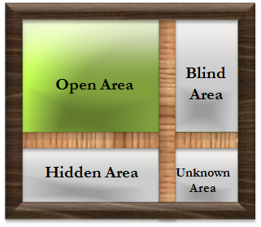
Ideal Shape of Johari Window
So, how can we achieve the ideal shape of the ‘Johari Window’?
This is the kind of person whom you can trust. As the people get to see and know you, exactly as you are and can trust you. Such a window has a small blind area so that you know what others think about you.
We need to understand, that the ideal shape of the window is one which has a large open area.

Slide 14
Johari Window for a New Team Member
Let’s take a look at the Johari window for a new team member within a new team.
Open / Free Area or
Public Arena
Blind Area
or
Blind Spot
For such a new team member, the open or free area is small because others know little about this new person.
Moreover, the blind area is small because others know little about this new person.
Also, a large area is occupied by the hidden or avoided issues and feelings.
The largest area is the unknown area because the person may be lacking in self-knowledge or belief as he is placed in a new environment.
Hidden Area
or
Façade
Unknown Area
or
Unknown Self

Slide 15
Uses of Johari Window
Johari Window has several usages in the organizational setting such as follows:
1
By taking into consideration the 3rd quadrant or the hidden area, we can try to understand the personal aspirations and motivations or priorities of a team member which the leader is unaware of. Such hidden aspirations cause inadequate contribution or misdirected efforts of that member.
2
The feedback provided to someone brings information which is in the 2nd quadrant or blind area to open area which helps in improvement and learning.

Slide 16
ManagementStudyGuide.com
This is a DEMO Course On – Johari Window.
Learn Management Concepts & Skills Rapidly with easy to understand, richly illustrated Self-Paced Learning Modules and Downloadable Powerpoint Presentations.
As a premium member, you get access to View Complete Course Content Online and Download Powerpoint Presentations for More than 120 Courses in Management and Skills Area.

