Slide 1
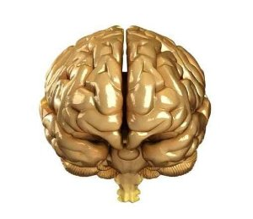


N L P
Core
Skills

Slide 2





Course Objectives
Explain What is NLP
Explain the Benefits of NLP
Describe the Four Pillars of NLP
Explain Model, Strategy and Technique
Explain NLP Modeling
Explain What are Representational Systems
Describe the Various Submodality Techniques
Explain What are Meta Programs
Explain the Reframing Technique
Explain the Mirroring and Matching Techniques
Describe the Different Satir Categories
Explain the Role of Sensory Acuity in NLP
Explain What is Anchoring
Describe the Various Stages of Learning
Explain How Criticism is Handled using NLP

Slide 3




Introduction
Howard Gordon is a Project Manager in Helium Inc.
He has been facing a lot of problems, both in his
as well as
professional
personal life.
with people properly nor
communicate
He is just not able to
motivate
them.
influence
or
him.
misunderstand
People also tend to

Slide 4
Introduction
He has gone through a lot of workshops on
self-improvement.
He also sought guidance from his boss who is a well known
and
influencer
motivator
of people.
just don’t
boss
However, the patterns that worked for his
work for
Howard.
work
for him?
How can Howard find out what would

Slide 5
Introduction
Howard can better motivate and influence people if he first understands his own
and
sub-conscious behavior
language patterns.
himself
at the
He should first understand
greater
in order to
achieve
sub-conscious level
and
personal life.
professional
in his
success

Slide 6
Introduction
or
Neuro Linguistic Programming
This is where
NLP
can prove to be helpful for Howard.
behavior
and
thinking,
NLP
is the study of our
so that we can build sets of
language patterns
decisions,
that work for us in making
strategies
coaching a team of people,
building relationships,
balance
motivating
others, creating
inspiring
and
our way through the day and,
in our lives,
negotiating
above all, learning how to learn.

Slide 7

Introduction
Let us learn about NLP Core Skills in detail.
or
Neuro Linguistic Programming
This is where
NLP
can prove to be helpful for Howard.
behavior
and
thinking,
NLP
is the study of our
so that we can build sets of
language patterns
decisions,
that work for us in making
strategies
coaching a team of people,
building relationships,
balance
motivating
others, creating
inspiring
and
our way through the day and,
in our lives,
negotiating
above all, learning how to learn.

Slide 8

History of NLP
NLP was created in the 1970s at University of Santa Cruz by Richard Bandler and John Grinder.
It is a set of psychological tools to improve personal performance.
It involves working with the connections between our mental processes and the language we use.
It is the study and application of subjective experience, particularly that resulting in excellence.
The co-founders of NLP noticed that there were three fundamental characteristics of really effective communicators that were shared by all of the therapists, excellent communicators and influencers that they studied.
It is based on linguistics, psychology and communication and has had extensive application in business, education, health, as well as in therapeutic change work.

Slide 9
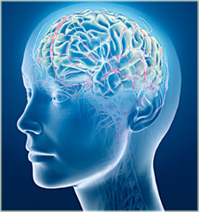
What is NLP?
Neuro Linguistic Programming (NLP) is a process of modeling the conscious and unconscious patterns that are unique to each of us in such a way that we are continuously moving towards a higher potential.

Slide 10

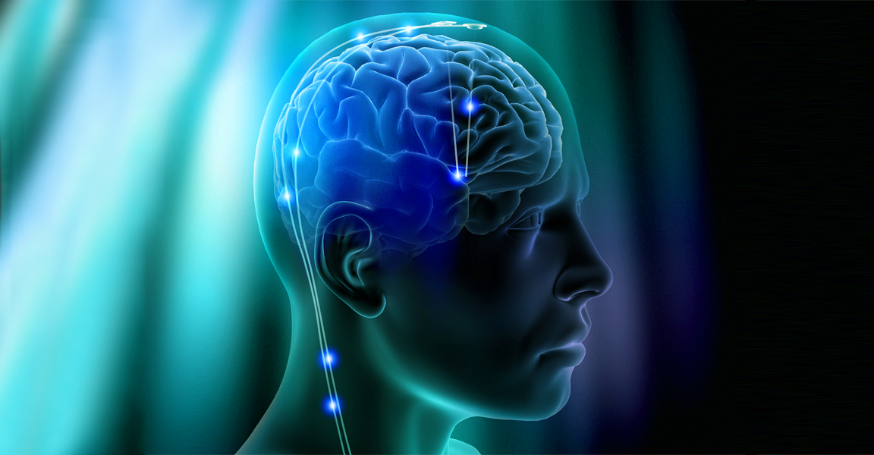
Purpose of NLP
Managing change effectively
Overcoming limiting behaviors
Communicating better
Developing resilience
Learning new practical business skills
Managing one’s emotional state better
Managing oneself better
Increasing self awareness
NLP is useful to people in many ways such as for:

Slide 11

Four Pillars of NLP
The following are the four pillars of NLP:
Rapport is about getting on with and trusted by another person.
Outcome Orientation is about knowing what you want and going for and ensuring it is in your control.
Sensory Acuity is about tuning into our senses and learning to make finer and more useful distinctions about the information we get from the world.
Behavioral Flexibility is about understanding the other’s point of view and how it adds to our ability to be highly effective communicators.
Outcome Orientation
Behavioral Flexibility
Rapport
Sensory Acuity

Slide 12

Did You Know?
NLP is more effective than psychology alone. Also, it is much less expensive. So, your goals can be reached in 1-3 sessions instead of numerous weekly appointments that can go on for years in psychological counseling. Using NLP, once you locate the source of the problem, it’s easy to replace or delete the behavior entirely.

Slide 13



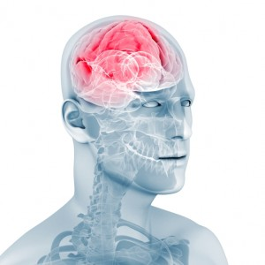
Phases of NLP Modeling
This phase involves fully imagining yourself in someone else's shoes by using what is known as a ‘second position shift’ in NLP.
Hence, you use direct observation of behavior and physiology to find "what" the person does and ask quality questions to find out "how" they do it which involves internal thinking strategies and "why" they do it which includes his supporting beliefs and assumptions.
Observing
the model
A powerful tool to use in this part of the process is deep trance identification. Deep trance identification is using unconscious clues to generate more information than can be obtained logically.

Slide 14

Submodality Distinctions
Visual
Olfactory and Gustatory
Visual
Brightness, size, shape, location, distance, contrast, focus, clarity, movement, speed, perspective, framed/panoramic, orientation, density, transparency, color/black and white.
Kinesthetic
Auditory

Slide 15

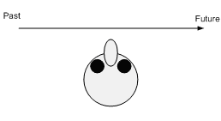
Thru-time - Learning from Experience
The other timeline type is Thru-time (or through time). When a person uses this way of representing time, he stores memories left to right or right to left, or some way where time is in front of them.
Someone with this timeline type is always aware of time passing. Such people are generally on time or even early for appointments. For such people being on time is a priority and even more important than the appointment.
An advantage of this timeline is that past experiences can be used as references and learned from. A major disadvantage is that some of these past experiences can be un-resourceful. Such a timeline is great for planning, staying on track or to meet deadlines.
In-time
Thru-time (or through time)

Slide 16
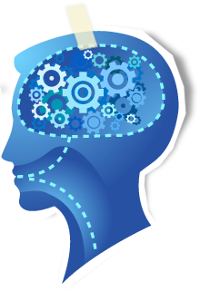
Beliefs and Values
Abilities, behaviors and purposes are driven by beliefs, that is, they out frame.
They have a frame of validation or confirmation.
Hence, what we believe doesn't make it real, only subjectively.
It actualizes in body, mind and behavior.

Slide 17
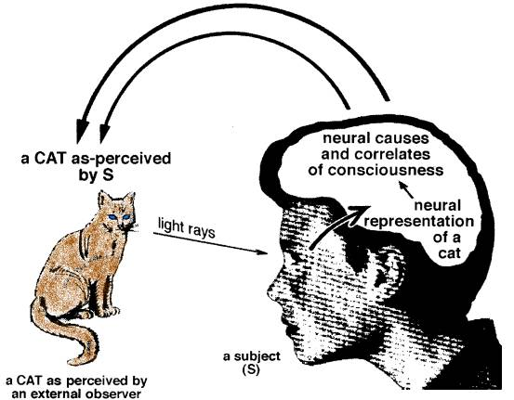
Visual or Kinesthetic Dissociation (VK/Dm)
Visual or Kinesthetic Dissociation is also known as VK/Dm technique. This technique is used to lessen the undesirable set of emotions or feelings that are related to an event of the past. A past experience of a person is recreated in the mind. Then the person observes this scene from a distance as a mere bystander. The scene from the past can be played like a motion picture, even in reverse sometimes. This is where the person tries to remove himself from being involved in the entire scene and reach a disassociated state. Such a dissociated state helps the person to remove any bad thoughts or feelings related to the event because he is now playing the part of a spectator. This technique is greatly influenced by various techniques such spatial sorting by Fritz Perls, technique of changing history, or some aspects from Eriksonian technique.

Slide 18


Fundamental Areas of Sensory Acuity
Lower lip changes
Lower lip changes:
Observing the lower lip gives you a lot of information about the person’s inner feelings.
Observe the shape, color, size, texture, edges, stretching and movement of the lower lip.
Observe the minute changes; create a map of the emotion as per the state of the lower lip.
Calibrate the emotions, and compare with other people as well.

Slide 19


NLP and Handling Criticism
Criticism can be effectively handled by using the Neuro-linguistic frame. Emotion can be removed from an experience by using the dissociative frame. This procedure was developed by modeling people who are able to turn criticism into feedback.

Slide 20
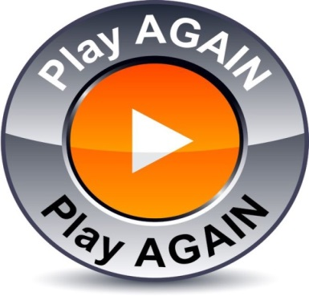
ManagementStudyGuide.com
This is a DEMO Course On – NLP Core Skills.
Register Today and Get Access to 5 FREE Courses.
What Do you Get:
View All Courses Online.
Download Powerpoint Presentation for Each Course.
Do the Knowledge Checks for Each Course.

