Slide 1
Self-Motivation

Slide 2
Objective
Explain What is Motivation
Explain What is Self-Motivation
Describe the Importance of Self Motivation
Explain the Steps to Self- Motivate Yourself
Explain What is Self-Confidence
Explain What is Self-Determination
Explain the Locus of Control
Describe the Can-Do Attitude
Explain Visualization and Success
List the Differences between Self Motivated and Non Self Motivated Person

Slide 3
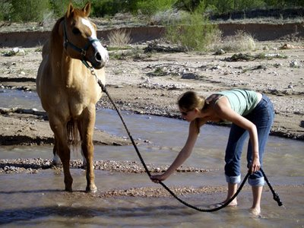
Introduction
You must have heard the famous proverb -
‘You can lead a horse to water but you can’t make it drink’
This proverb is true for not some of the people but for everyone. Unless and until a person himself wants to do something, no-one can make him do it without his will.
This is where self-motivation plays a key role. No matter how much motivation external agents may provide to a person, unless and until a person is self-motivated, he will not be ready to face and achieve the greater goals of his life and to fulfill his destiny
Let us now learn in detail about self-motivation

Slide 4
What is Motivation?
Motivation is an inferred process within an animal or an individual that causes that organism to move towards a goal.
Motivation is a process which initiates, directs and sustains behavior to satisfy various needs or wants.

Slide 5
Three Elements of Motivation
•
•
Motivation starts with the desire to be free, to be free from dependency on others, freedom to live the lifestyle we dream of, freedom to explore our ideas
Total freedom is not possible or desirable, but the struggle to achieve that ideal is the basis for motivation

Slide 6
Four General Approaches to Motivation
Being Needs
Maslow’s Hierarchy
Humanistic Approaches
Behavioral Approach

Slide 7
What is Self-Motivation?
Self motivation is the inspiration behind your behavior and actions. It is a self-action to energize your mind.
Tips for Self Motivation:
Dream
Make concrete Plans
Positive Attitude
Start with a small step
Block external forces
Be consistent
Avoid procrastination
Never Quit.

Slide 8
Importance of Self Motivation
Self motivation is important aspect of your life – whether it is social life, relationship, personality development etc.
Find out what motivates you. People get motivated by reading books or by influential people.
If you are able to motivate yourself, there is no need to depend on external factors. Self motivation is the best inspirational technique.

Slide 9
What Motivates You?
•
•
•
Most people are motivated to do easy and interesting activity
People are motivated to get good results for an unpleasant activity
If you are not motivated to do something, you either:
Have not figured out what you want out of the activity.
Do not value what the activity will produce.
Are focused on short term thinking instead of long term thinking

Slide 10
Steps to Self- Motivate Yourself
Step 1 – Get Out of Your Comfort Zone:
Br prepared to quit your comfort zone.
Your comfort zone is your greatest barrier to achieve your goals.
Things become easier if you make friends with your discomfort zone
Step 5 – Self Development:
Spend at least one hour a day in self-development.
Read good books or listen to inspiring tapes.
Driving to and from work provides an excellent opportunity to listen to self-improvement tapes
Step 3 – Stop Limiting Yourself:
Don't indulge in self-limiting thinking.
Think empowering, expansive thoughts
Step 4 – Be Happy:
Choose to be happy.
Happy people are easily motivated.
Happiness is your birthright so don't settle for anything else
Step 2 – Mistakes Happen:
Don't be afraid to make mistakes.
Wisdom helps us avoid making mistakes and comes from making a million of them

Slide 11
ManagementStudyGuide.com
This is a DEMO Course On – Self Motivation.
Join MSG Premium Membership and Get Access to around 160 Courses + New courses added every week.
What You Get:
View All Courses Online.
Download Powerpoint Presentation for Each Course.
Do the Knowledge Checks for Each Course.

