Slide 1
Customer
Supplier
Retail
Procurement
Manufacture
Introduction
to
Supply Chain Management
Logistic
Product
Distribution
Inventory

Slide 2
Course Objectives
Explain the Importance of SCM in an Organization
Define What is Supply Chain Management
Explain Supply Chain Network Design (SCND)
Explain What is Demand Planning
Describe the Role of IT in SCM
Describe the Role of Logistics in SCM
Explain What is Global Supply Chain Management
Explain What is Finished Goods Supply Chain
Explain What is Reverse Logistics
Explain What is Vendor Managed Inventory (VMI)
Describe the Functions of Warehouse Management
Explain Factors of Warehouse Operational Efficiency
Explain Steps to Improve Throughput of Process Chain
Explain Key Issues of Supply Chain Management
List Tips for Effective Supply Chain Management

Slide 3
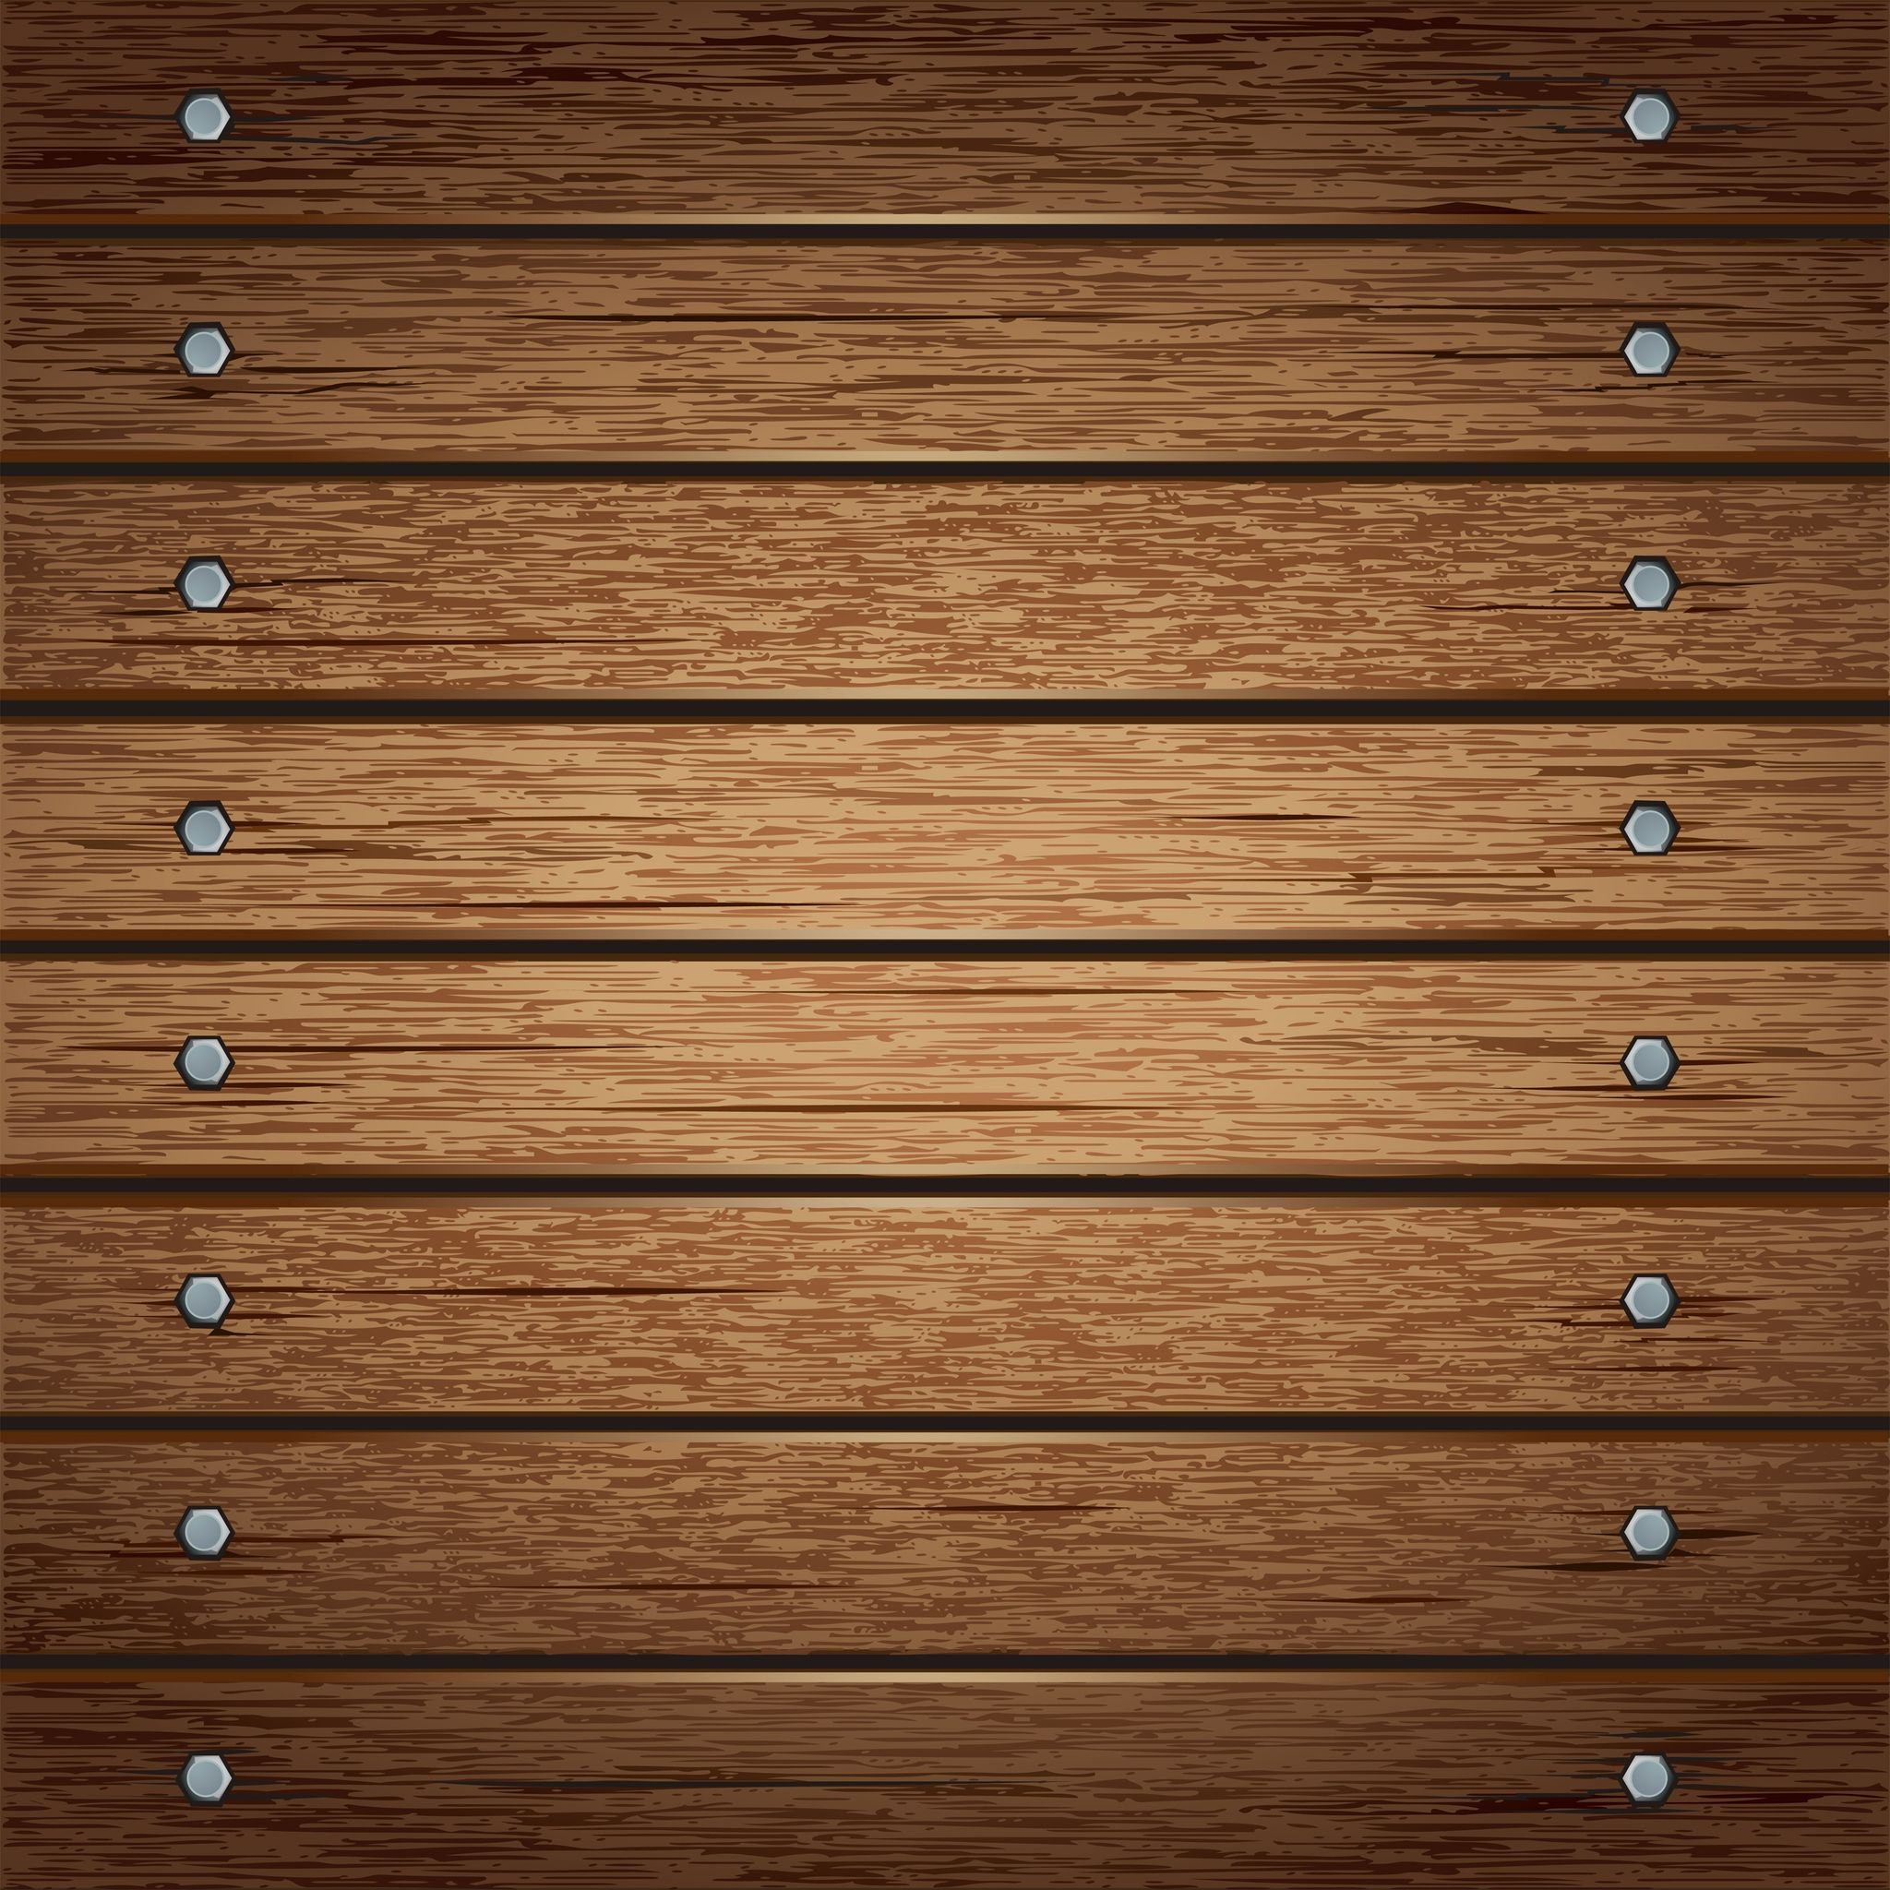
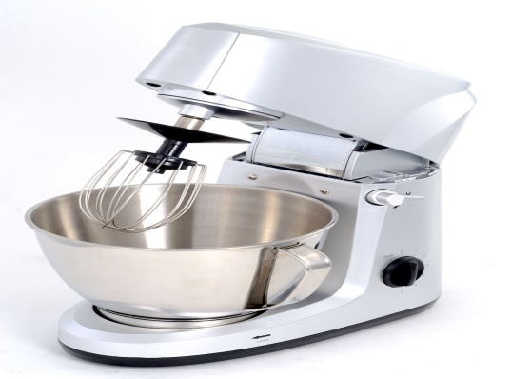
Introduction
Look at the various products shown below.

Slide 4
Introduction
Look at the various products shown below.
So, have you ever noticed the labels on such products?
Where are the majority of such goods manufactured?

Slide 5
Introduction
You will find that many of the goods such as electronics, and white goods or even clothes have been manufactured in China, South America or Mexico.
Mexico
China
South America

Slide 6
Introduction
So, many times the cocoa that you buy has come from Africa or the coffee pods you buy have come from Brazil.
Africa
Brazil

Slide 7
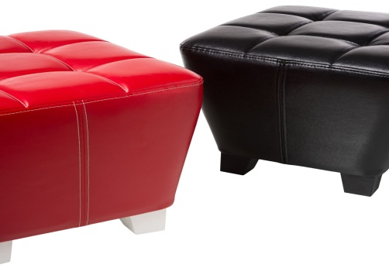
Introduction
Most of the computers have been shipped out of South American Factories and Soft furnishings on the shelves are from India and Hong Kong.
India
Hong Kong
South America

Slide 8
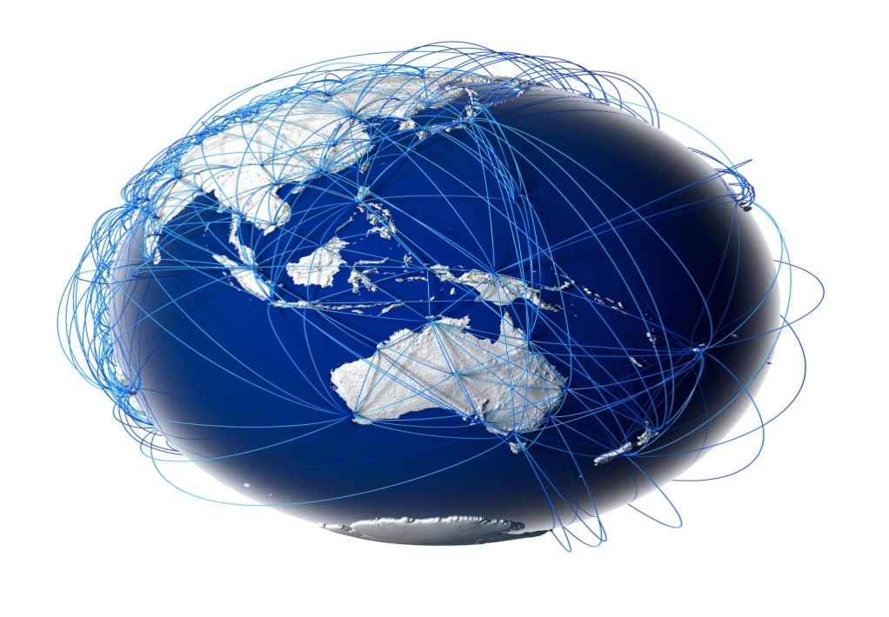
Introduction
Thus, the expanding global markets are re-defining the way demand and supplies need to be managed. Global companies are driven by markets across continents.

Slide 9
Introduction
Hence, to keep the cost of manufacturing low, they are forced to set up production centers where cost of raw materials and labor is cheap.
Cheap
Raw Materials & Labor
Low Cost of Manufacturing

Slide 10
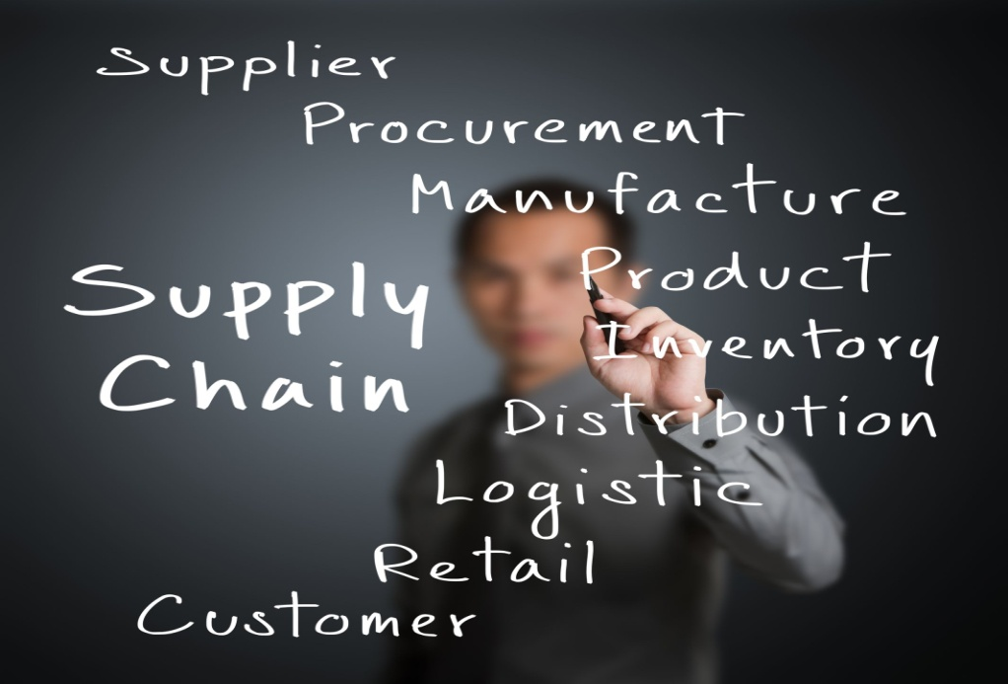
Introduction
‘Supply Chain Management’ is also called the art of management of providing the ‘Right Product, At the Right Time, Right Place and at the Right Cost to the Customer’.
Let us learn about ‘Supply Chain Management’ in detail.

Slide 11
Importance of SCM in an Organization
Supply Chain Strategies are the critical backbone of business organizations today. Effective market coverage, availability of products at locations which hold the key to revenue recognition depends upon the effectiveness of Supply Chain Strategy rolled out. Very simply stated, when a product is introduced in the market and advertised, the entire market in the country and all the sales counters need to have the product where the customer is able to buy and take delivery. Any glitch in the product not being available at the right time can result in drop in the customer interest and demand which can be disastrous. Thus, design of transportation network and management assume importance to support sales and marketing strategy.

Slide 12
Drivers of Supply Chain Dynamics
Since a supply chain is dynamic and chaotic, its structure must be very flexible to cope with capricious market demand and severe levels of competitions. A supply chain must be able to change its pattern easily to gain a competitive advantage.
Drivers
Customer satisfaction
Technology change
Connections
Internal factors
Multi-echelon decision making
Scratched together partners
Supply Chain Dynamics
Competitiveness
Flexible manufacturing
Efficient operation
Agility response
Negative effects
Information-distortion/delay
Bullwhip effect
Boom and bust

Slide 13
Inputs and Outputs of the SCND
INPUTS
Existing locations of stores. For the new web-based businesses, without any physical stores, the equivalent inputs will be the number of individual orders fulfilled in specific region
Existing and/or proposed locations of warehouses or factories. This may also include the locations of the shipping warehouse for the major vendor
Products carried at each of the location
Fixed and variable cost models for each of the locations for stocking, handling, shipping and other warehousing activities
Cost mode for transportation lanes/routes between the above nodes and transportation mode
Multiple scenarios with different locations and cost of running the network in each scenario
Projected product volumes at nodes and flow paths
OUTPUTS

Slide 14
Push/Pull Strategies
Pull
Customization is High
Demand is uncertain
Scale economies are Low
E.g., Computer Peripherals
Demand is uncertain
Scale economies are High
Low economies of scale
E.g., Furniture
High
Demand of uncertainty
Uncertainty is low
Low economies of scale
Push-pull supply chain
E.g., Stationeries
Standard processes are the norm
Demand is stable
Scale economies are High
E.g., Soft drinks
Low
Low
High
Push
Economies of scale
Pull
Push

Slide 15
Logistics in Supply Chain Management
Supply chain design in an organization would detail, plan and strategize the procurement strategy, selection of manufacturing location, design and develop distribution network and strategy for finished goods etc. While logistics planning would deal with the details of procurement logistics, finished goods distribution, sales order fulfilment and inventory management etc. Logistics planning derives the strategic direction and framework for its design planning from SCM Strategy.

Slide 16
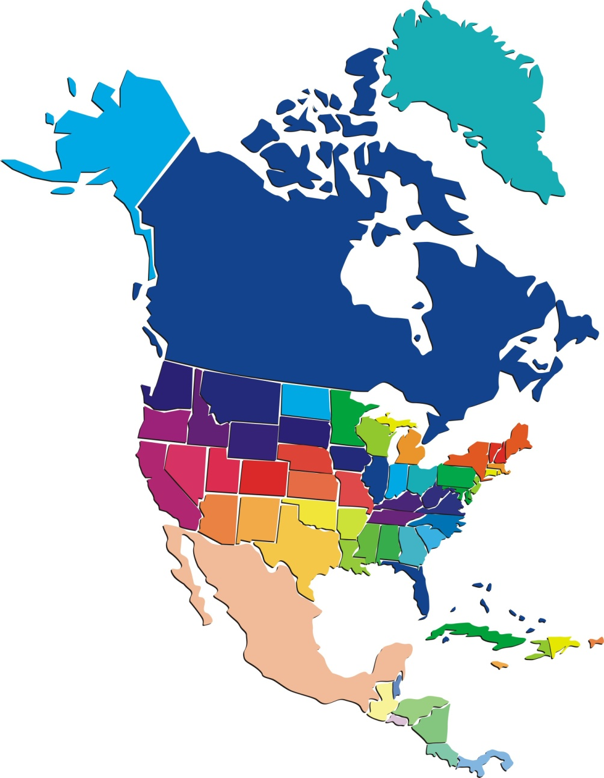
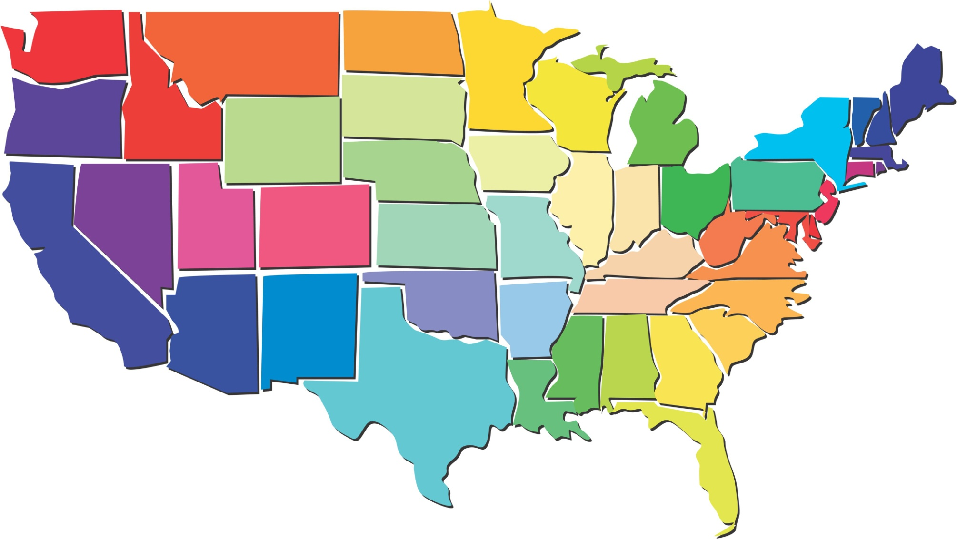
Real Life Example
Dell has manufacturing facilities located in Austin-Texas, North Carolina, Miami, Florida that service US Markets.
North Carolina
Austin-Texas
Miami, Florida

Slide 17
Finished Goods Supply Chain
Finished Goods supply chains are very dynamic and are the backbone of a good sales organization.
A number of departments are responsible to work in coordination and seamlessly to ensure Finished Goods reach the markets and the customers.
Logistics and supply chain departments have to work in tandem with or aim to be ahead of Marketing and Sales and ensure that when a product is announced for sale by marketing, the products are made available at all nook and corner of the city, state and country.
A situation where the customer goes to a sales counter to place an order and the product is not available cannot and should never happen as a rule.

Slide 18
Advantages of Reverse Logistics
1
The following are the advantages of Reverse Logistics:
Reverse Logistics offers several advantages to the company in terms of both tangible and intangible benefits. In the first instance, companies are able to retrieve defective equipments and parts which are either salvaged or refurbished and thus reclaim value out of the defective parts.
2
Distributors are more likely to be open to stocking all fast moving as well as slow moving stocks. Also, the packaging and defective materials are collected and recycled, thereby generating scrap value back for the company.

Slide 19
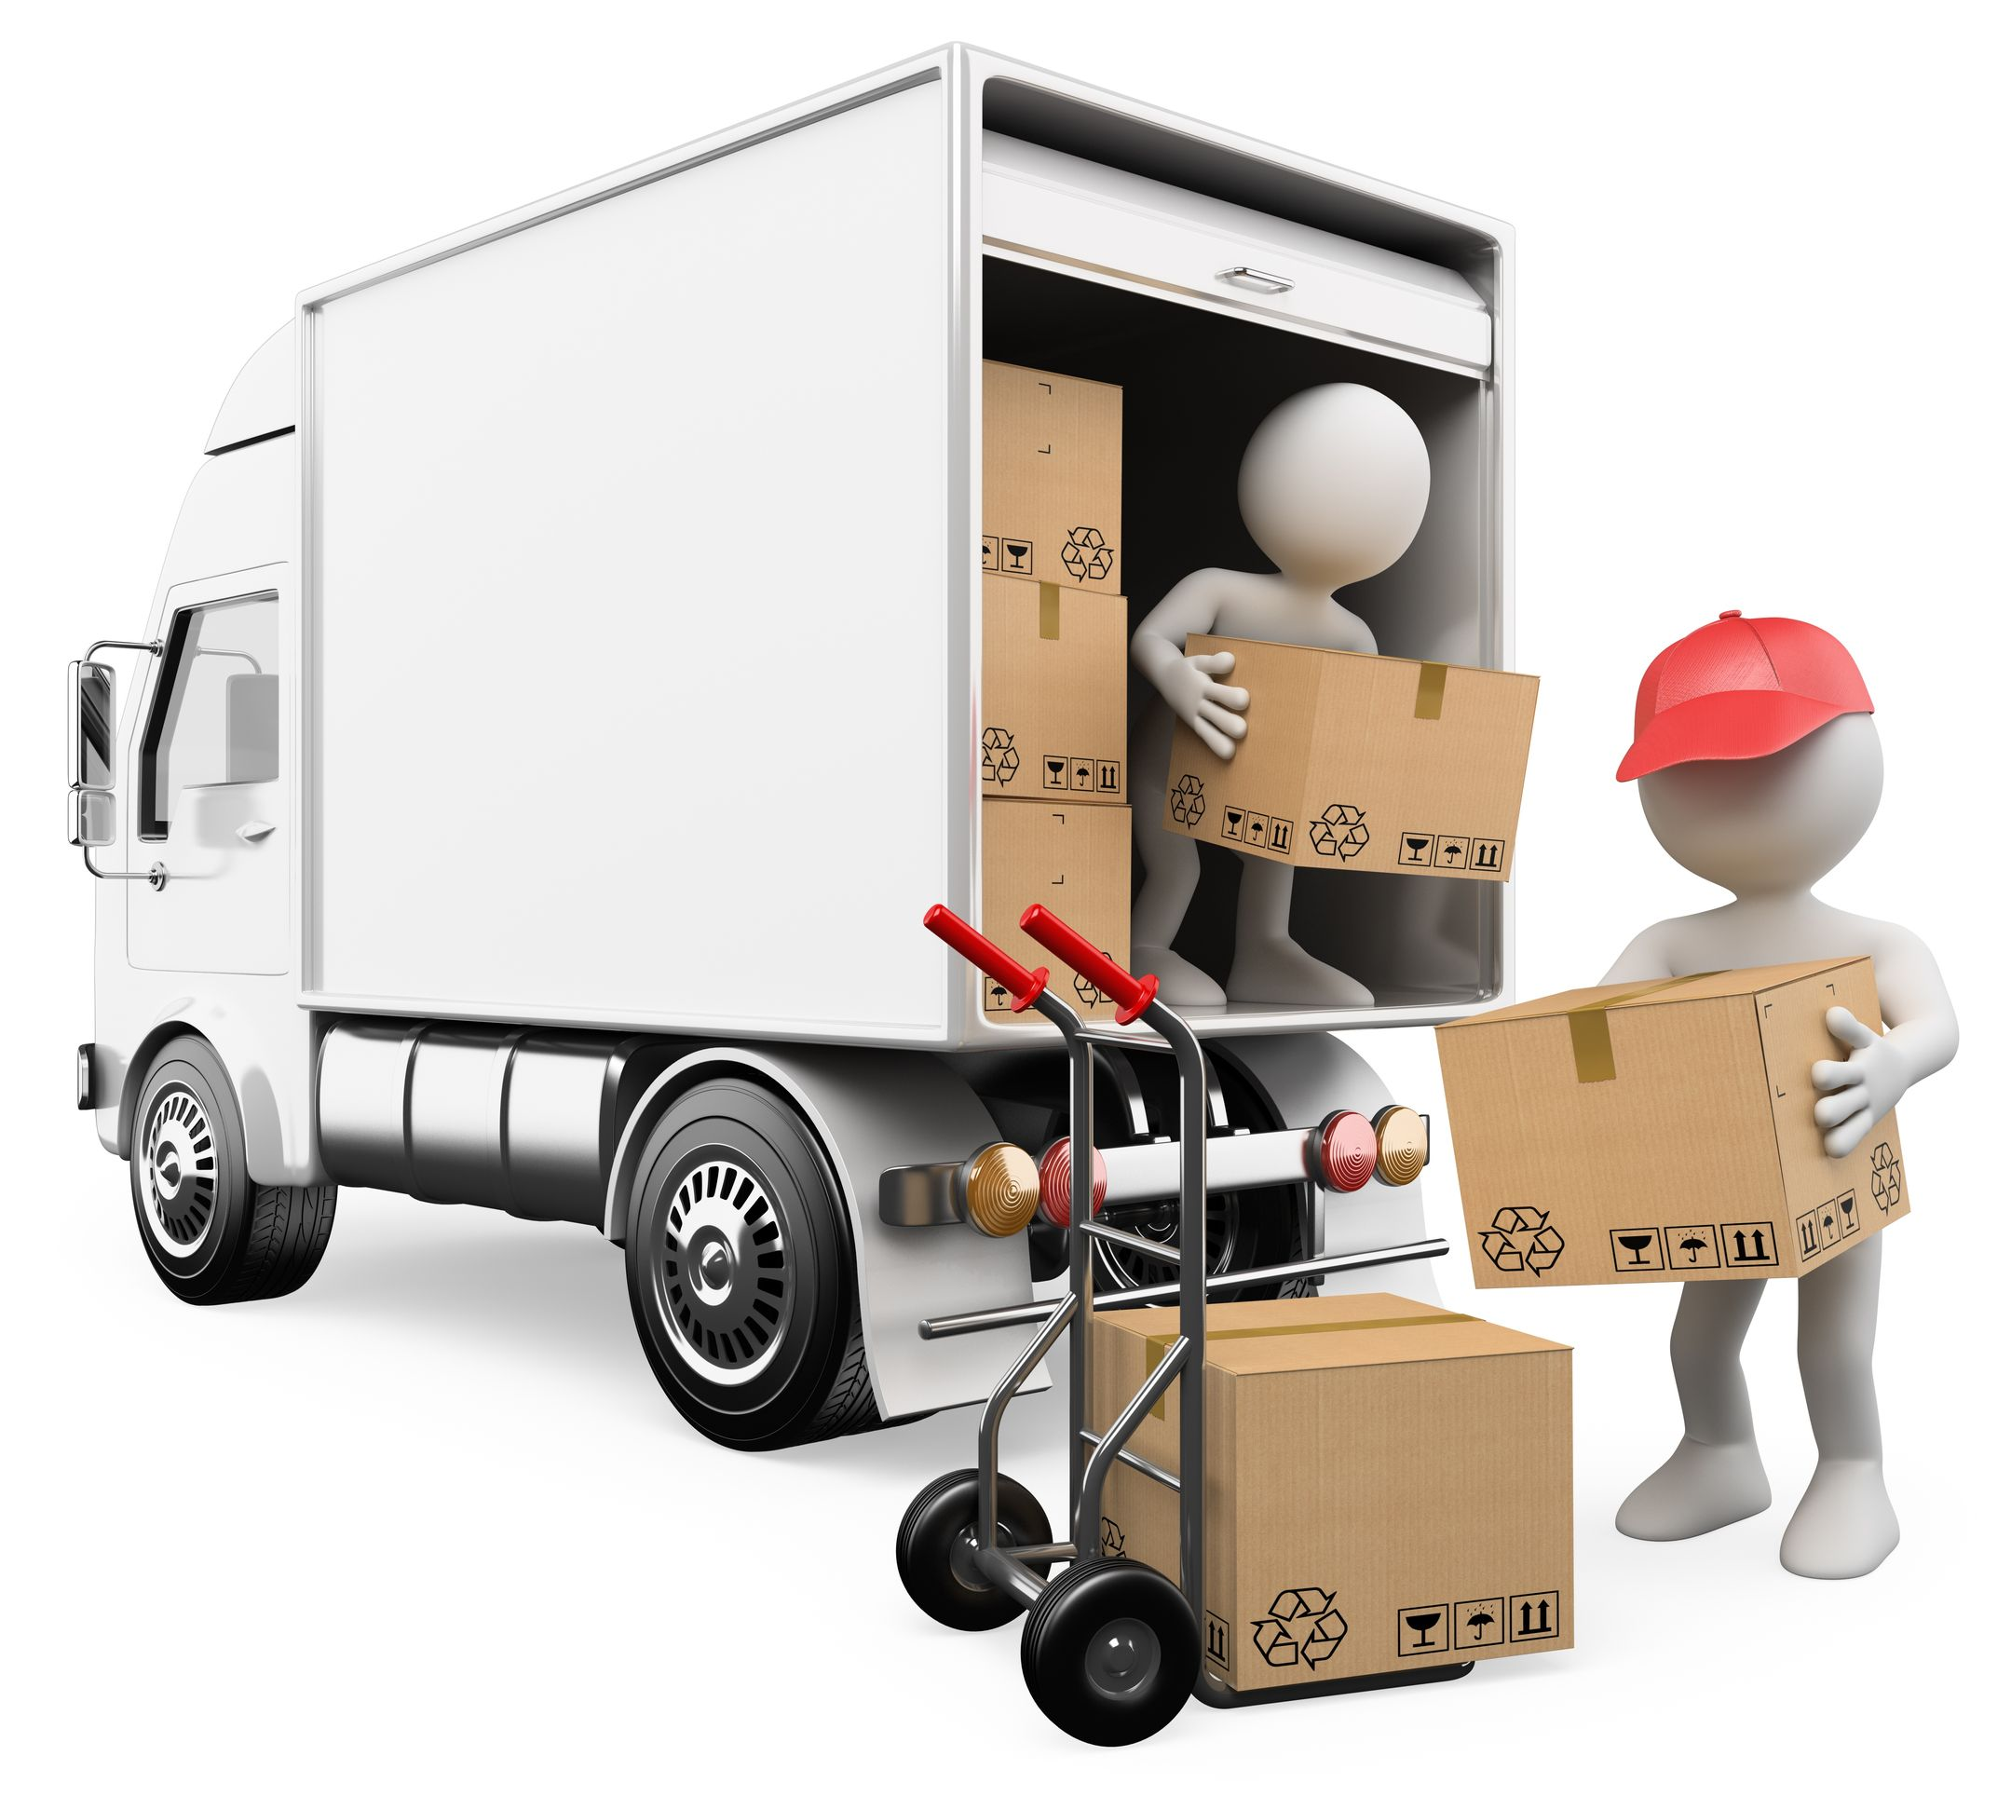
Vendor Managed Inventory (VMI)
The supplier should agree to own the inventory until the point of call off and continue to monitor and manage the inventory besides ensuring replenishments. The customer being the distributor or a manufacturing plant in this case appreciates the supplier initiative and takes an interest in coordinating and cooperating with supplier and supervises at times the 3PL who is situated at his premise or at a nearby location.

Slide 20
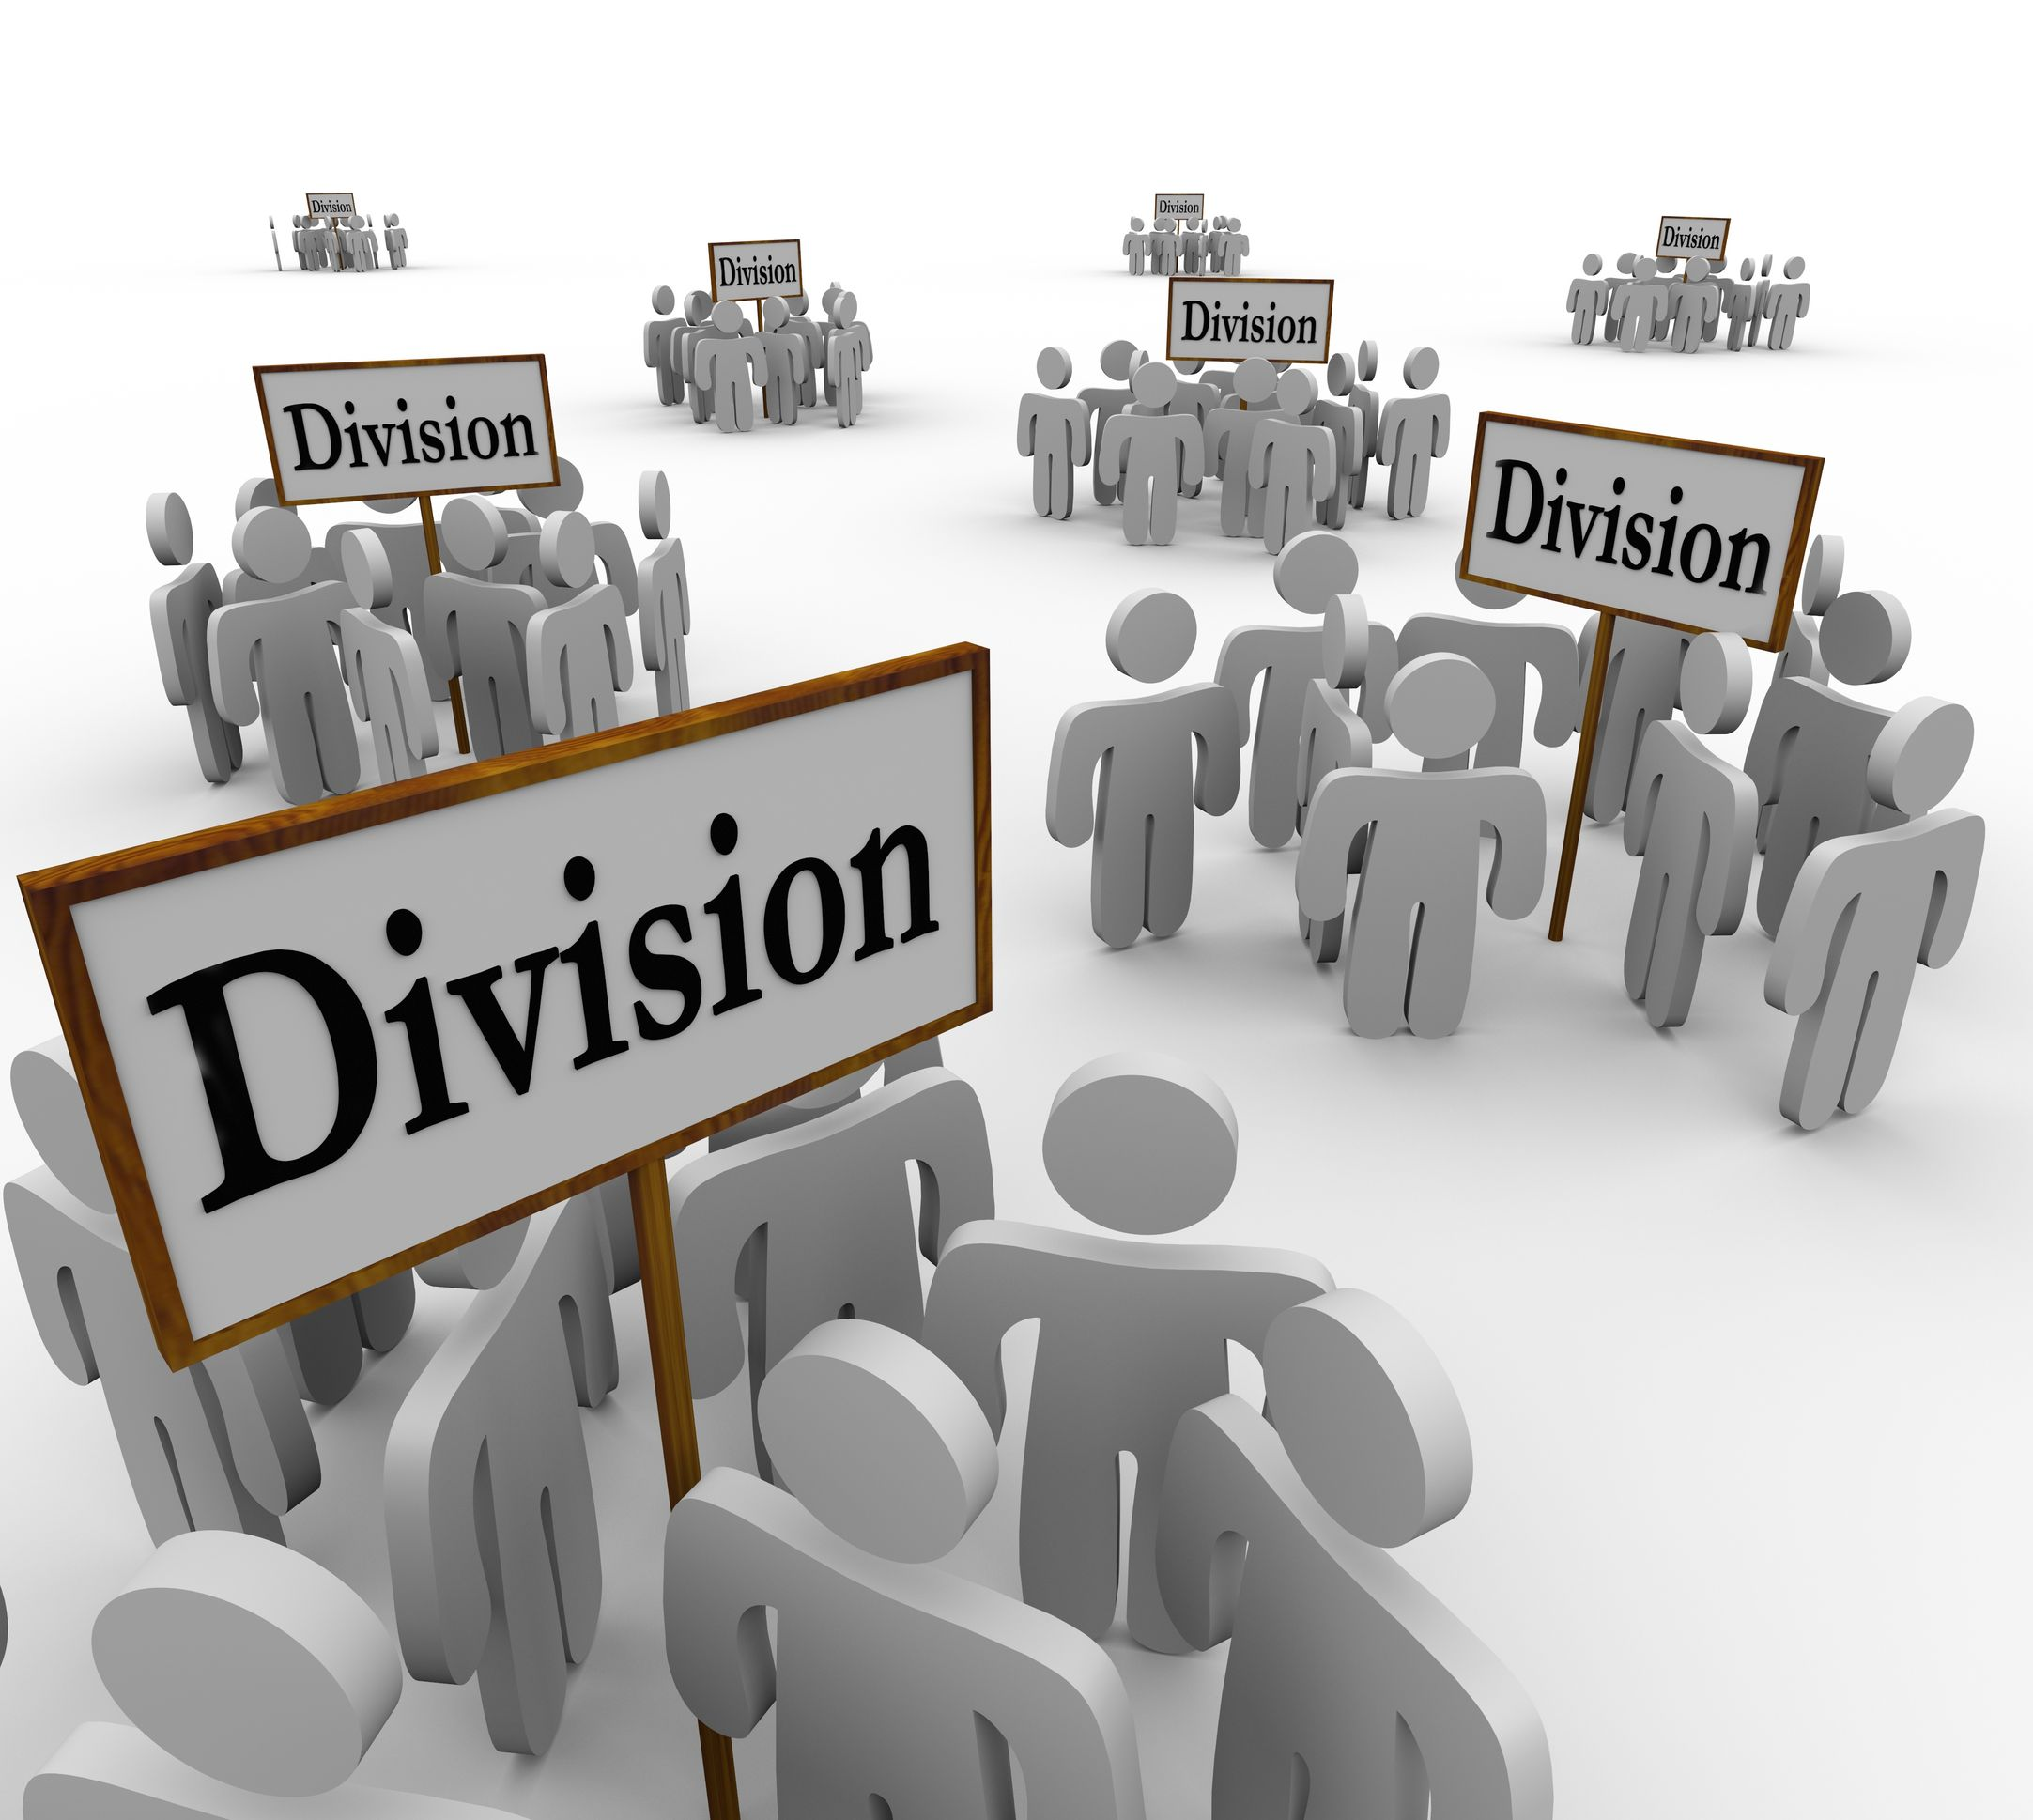
Factors affecting Warehouse Operational Efficiency
People
Workforce – Quantity & Job Structure:
Many times in third party managed warehouses, workforce strength is often an issue which affects the operational efficiency. It has been noticed that few local managements try to cut corners by under staffing at various levels and extending the working hours or job responsibilities and trying to save costs. There can be several instances of shortage of manpower from the strength that has been planned and budgeted for.
Workforce –
Quantity & Job Structure
Workforce –
Quantity & Job Structure
Right Skill Sets
Attitude and Outlook

Slide 21
Supply Chain Processes Reducing Various Costs
Distribution costs primarily consist of warehousing and transportation supply chain processes that can help reduce these costs are network, planning, warehouse management and transportation management
Distribution
Labor
Merchandise
Labor costs for retailers are in the warehouse and the stores. Warehouses management processes can help directly reduce the labor costs in the warehouse by better labor planning, scheduling and task tracking
These costs can be reduced through the strategic sourcing, bid optimization and supplier contracts-based optimization. Good demand forecasting and supply management practices also help in reducing cost of merchandise

Slide 22
ManagementStudyGuide.com
This is a DEMO Course On – Supply Chain Management.
Register Today and Get Access to 5 FREE Courses.
What Do you Get:
View All Courses Online.
Download Powerpoint Presentation for Each Course.
Do the Knowledge Checks for Each Course.

