Slide 1
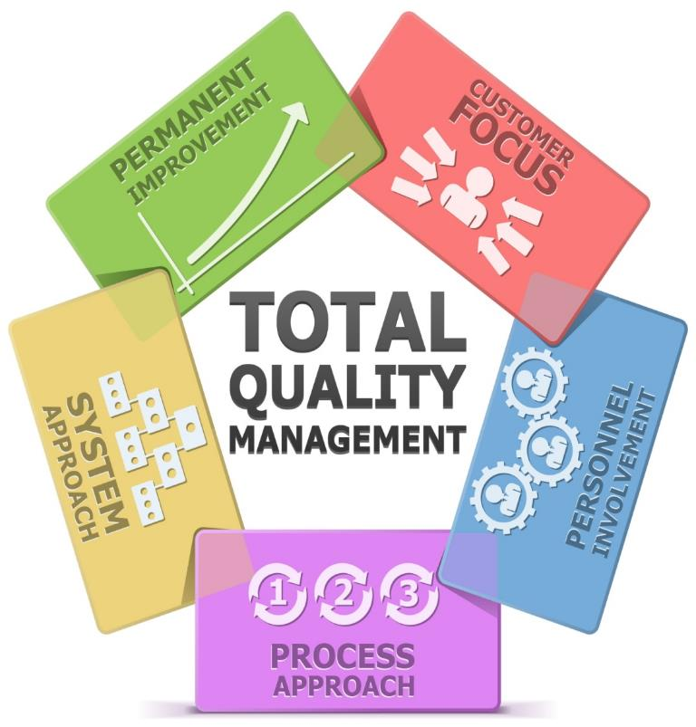

Slide 2
Introduction
Look at the products given below.
So, what do you think is common among all the given products?

Slide 3
Introduction
Yes, they are all ‘defective products’.
This means that each of the shown products has some or the other defect in it.

Slide 4
Introduction
No one would like to buy or use defective products. Hence, you can understand that it is very important that products as well as services that are delivered to customers should be free from defects to ensure customer satisfaction.

Slide 5
Introduction
When products and services are delivered with great ‘quality’, then such defect-free products and services help to build the prestige and brand of the company. Products with a good quality are of a superior grade or possess a degree or grade of excellence or worth.

Slide 6
Objectives
Explain What is Total Quality Management (TQM)
Describe the Evolution of TQM
Explain Concepts in TQM
Explain What is Cost Benefit Analysis
Explain the Principles of TQM Pyramid
Explain Kano’s Five Types of Quality
Explain Kinds of Measurements in TQM
Explain the STINGER Principle
Describe the Various Tools used in TQM
Describe the Focus Areas of TQM
Explain the Steps for the Quality Improvement Process
Explain Four Absolutes of Quality Improvement Process
Explain the Implementation of TQM
Explain Deming’s 14 Points to Improve Quality
List the Benefits of TQM

Slide 7
Evolution of TQM
The evolution of Total Quality Management (TQM) in history has taken place in four stages. These four stages are:
Stage 1: Quality Inspection (QI)
Stage 2: Quality Control (QC)
Stage 3: Quality Assurance (QA)
Stage 4: Total Quality Management (TQM)
Let us look at each in detail.

Slide 8
Kaizen
Some of the most important concepts in Total Quality Management (TQM) are:
Kaizen:
Japanese for “Change for better”.
Small, continuous improvements
Kanban
Deming Cycle
Kaizen
TQM
Let us look at each in detail.

Slide 9
6σ
What is Six Sigma?
•
•
•
•
Six Sigma is the measure of quality that strives for near perfection.
It is a disciplined, data-driven methodology focused on eliminating defects.
A Six Sigma defect is defined as anything that falls outside of a customer's specifications.
Six Sigma is a reference to a statistical measuring system, equivalent to just 3.4 defects per every million opportunities (Snee, 2003).

Slide 10
Tools used in Total Quality Management
There are many techniques that will be useful in planning for quality on a project. Some of the most commonly used tools in Total Quality Management (TQM) are as follows:
Cause and Effect Diagrams (or Fishbone or Ishikawa Diagrams)
1
Histogram
2
Scatter Chart/Scatter Diagrams/Dot Plot
3
Flowchart
4
Control Charts
5
Pareto Charts
6
Pie Charts
7
Bar Graphs/Bar Charts
8
Frequency Polygons
9
Line Graph
10
Ogive
11
Box-and-whisker Plots/Box Plots
12
Let us now look at each in detail.

Slide 11
Reduced Production Costs
The following are the key benefits of Total Quality Management (TQM) :
1
Reduced Production Costs
1
Reduced Production Costs
2
Reduced Overhead Costs
Total Quality Management (TQM) helps to significantly lower defect rates. Hence, the company can eliminate wastage of materials and inefficient use of labor which is associated with defects.
3
Improved Customer Satisfaction
4
Reduced Cycle Times
5
On-Time-Delivery
6
Greater Ease of Expansion
7
Higher Expectations
8
Positive Changes to Corporate Culture

Slide 12
ManagementStudyGuide.com
This is a DEMO Course On – Total Quality Management
Register Today and Get Access to 250+ Course Presentations.
What Do you Get:
Access the Courses Online.
Download Powerpoint Presentation for Each Course.
Get Certificates.

